Slide 1
ECDC support to Member States for strengthening capacities in emergency preparedness
Global Platform for Disaster Risk Reduction
22-26 May 2017, Cancun Mexico
Massimo Ciotti

Slide 2
What EU NFP for Preparedness want
* Note that this is potential support, depending on the availability of resources, ECDC can provide support. Also note that this is for planned needs. Support during emergencies/outbreaks can be requested ad hoc.
** PHE(P) = Public Health Emergency (Preparedness)

Slide 3
ECDC Country Preparedness Support
Support EU implementation of Decision 1082/2013/EU to enhance preparedness for serious cross-border threats to health
Support country-level public health emergency preparedness planning and implementation in the field of communicable diseases
Facilitate cross-border and intersectoral collaboration in the field of public health emergency preparedness with relevant EU and international partners
Coordinate and steer preparedness activities within ECDC as related to relevant disease programmes and core public health functions
Health Emergency Preparedness
Identification of evidence
Literature review
Case studies
Dissemination of good practice
Development of tools
Good practice workshops
Capacity strengthening
Training
Simulation exercises
Supporting countries in implementing Decision 1082

Slide 4
ECDC’s contribution to EU
capacity to manage emergencies
Plan
Do
Check
Act
PUBLIC HEALTH EMERGENCY PREPAREDNESS
Notes:
Preparedness and Response at ECDC
The preparedness and response planning activities of the European Centre for Disease Prevention and Control (ECDC) aim at ensuring that the European Union (EU) and its Member States are fully prepared to effectively respond to any communicable disease threat.
To meet this overarching objective, ECDC supports the European Commission by developing tools and guidelines to assist Member States in evaluating their level of preparedness, identifying potential gaps and vulnerabilities, and strengthening their capacities where needed.
This is a selection of ECDC publications related to the theme of this conference.

Slide 5

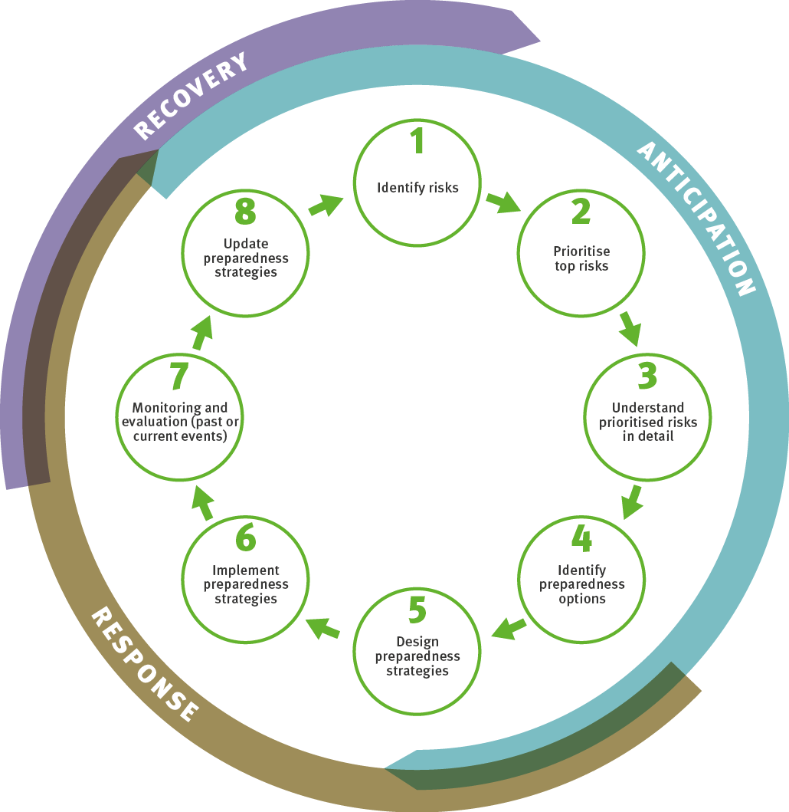

RISK ASSESSMENT AND PLANNING

Slide 6
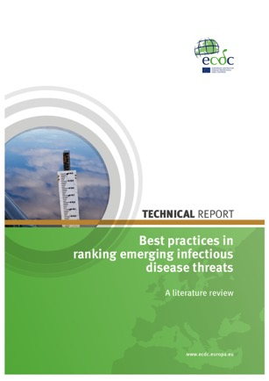
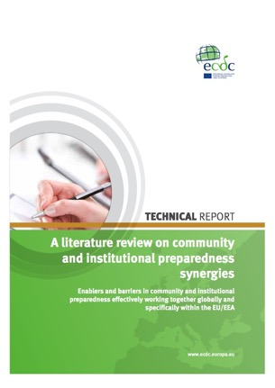
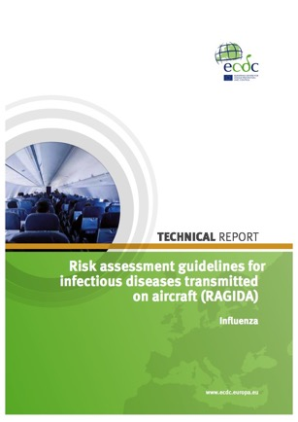
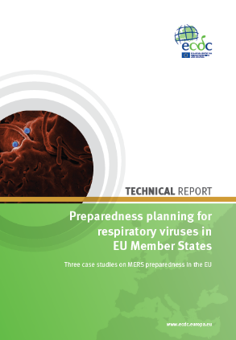
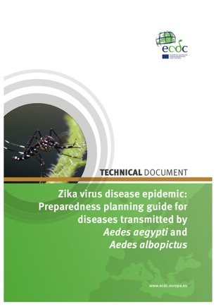
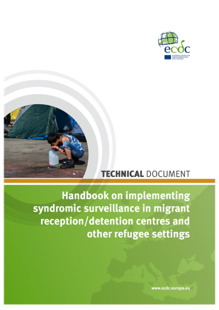
Notes:
Operational guidance on rapid risk assessment methology
Handbook on strategic planning for PHEP
Best practices in ranking emerging infectious disease threats: a literature review
Operational guidance on rapid risk assessment methodology
Risk assessment guidelines for infectious diseases transmitted on aircraft (RAGIDA) - Influenza
A literature review on community and institutional preparedness synergies: enablers and barriers in community and institutional preparedness effectively working together globally and specifically within the EU/EEA
Preparedness planning guide for diseases transmitted by Aedes aegypti and Aedes albopictus
Zika virus and safety of substances of human origin – a guide for preparedness activities in Europe
New ECDC tools: Strengthening preparedness and surveillance in migrant reception centres

Slide 7
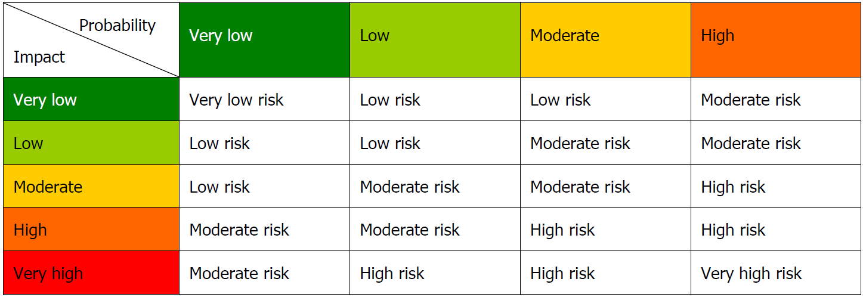
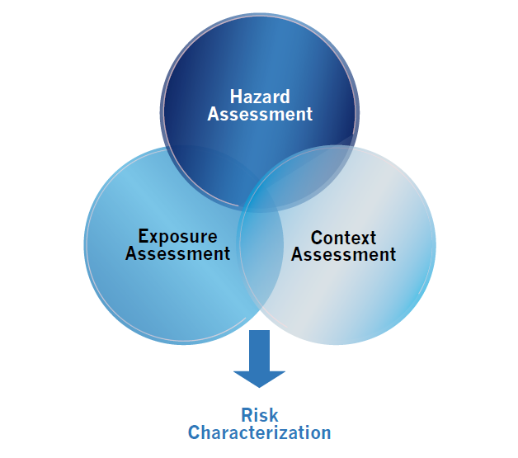
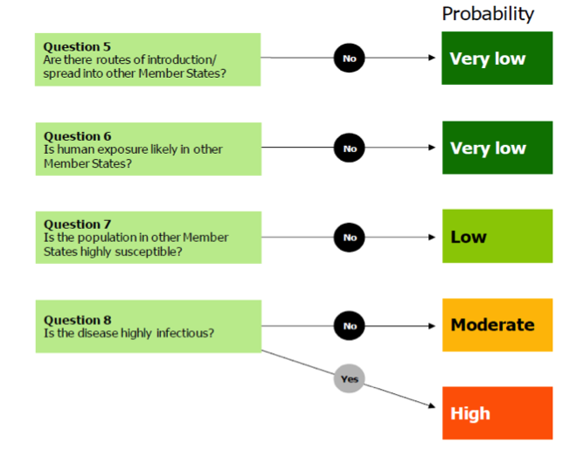
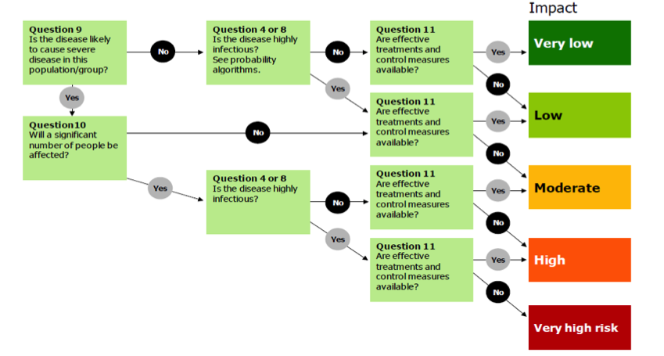

Slide 8
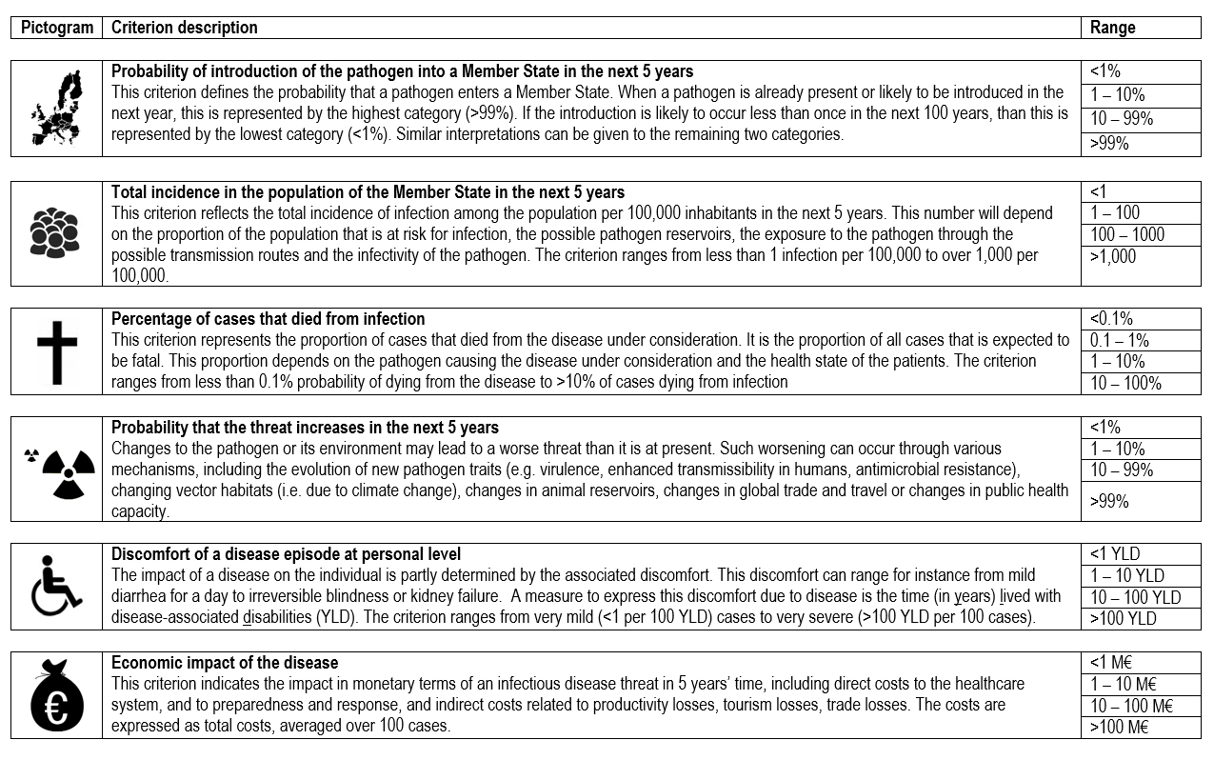
Ranking criteria

Slide 9
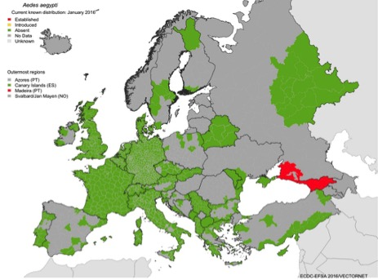
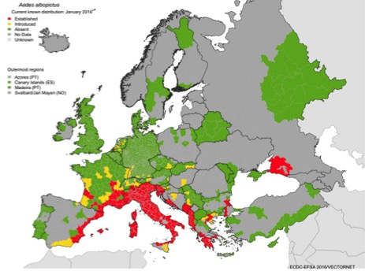
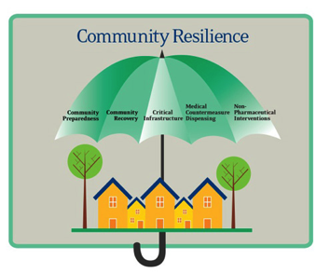
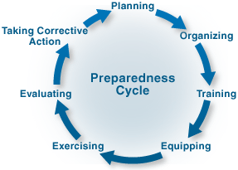
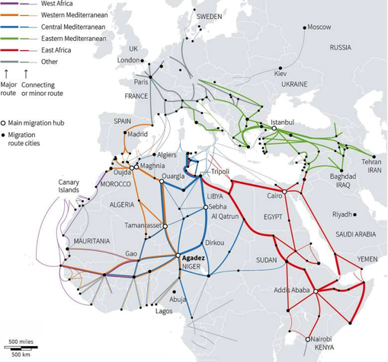
Distribution of the Aedes aegypti and albopictus mosquitoes as of January 2016
Aedes aegypti
Aedes albopictus
Established Introduced Absent No data/unknown
Migration flows into Europe

Slide 10

Training and Exercising

Slide 11

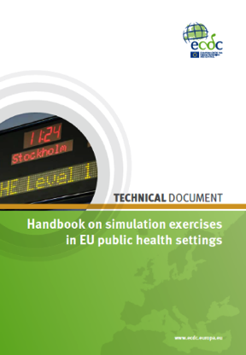
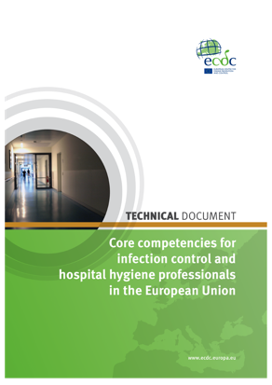
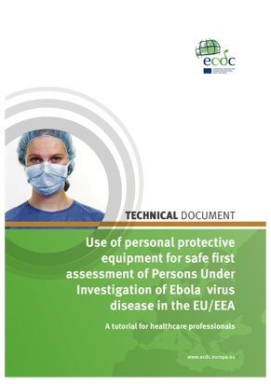
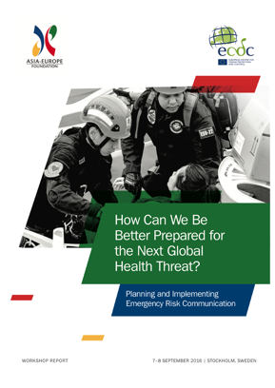
DRAFT
Core competencies for Public Health Emergency Preparedness
Notes:
Social media strategy development – a guide to using social media for public health communication
Handbook on simulation exercises in EU public health settings – how to develop simulation exercises for supporting preparedness and response to communicable diseases
Core competencies for infection control and hospital hygiene professionals in the European Union
Safe use of personal protective equipment in the treatment of infectious diseases of high consequence – a tutorial for trainers in healthcare settings
Use of personal protective equipment for safe first assessment of persons under investigation of Ebola virus disease in the EU/EEA – a tutorial for healthcare professionals
How can we be better prepared for the next global health threat? Planning and implementing emergency risk communication (Joint ASEF-ECDC report)
Core competencies for PHEP

Slide 12
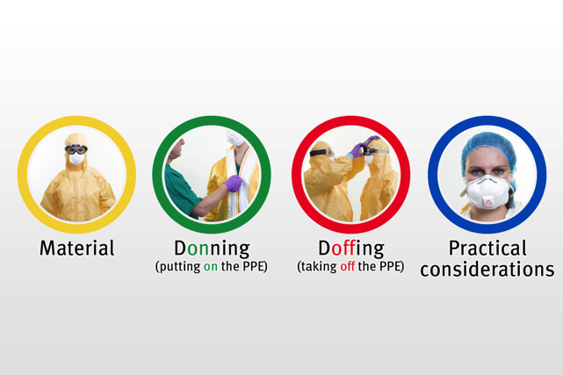
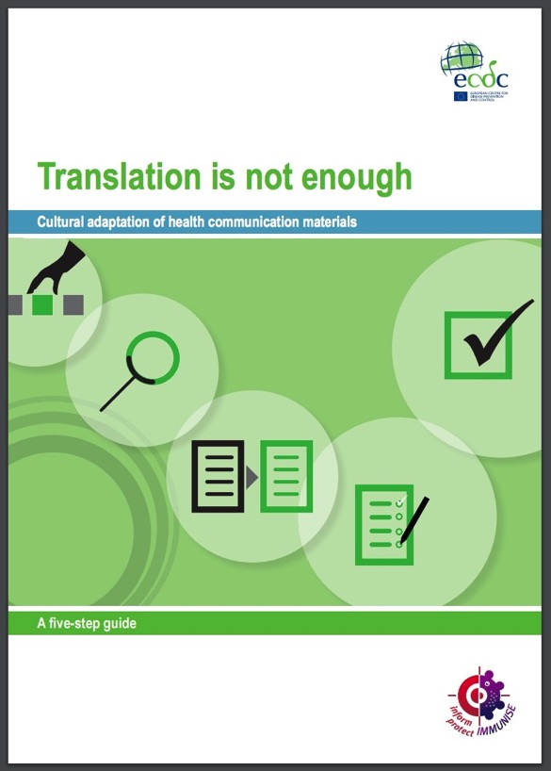


Slide 13
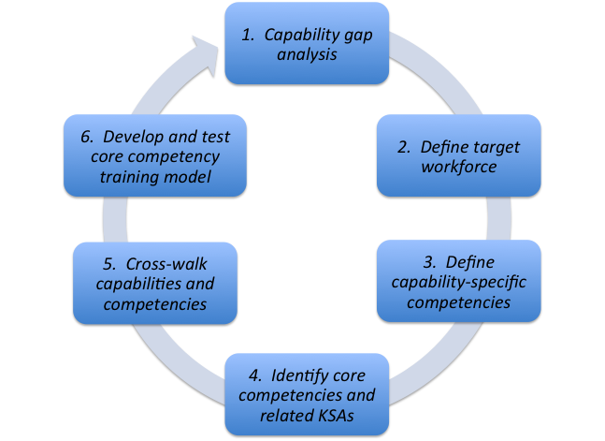
ECDC Logic Model for PHEP
Source: Technical report: Development of a Public Health Preparedness Competency Model for EU Member States, ECDC 2017
Notes:
Six-step approach to the development of a competency model
ECDC project aimed at developing competency-based training programs.
Competency-based training curricula for experts working in preparedness at the national level in the Member States. “Competency-based” means that training participants acquire knowledge and skills based on a defined set of core competencies they need to best fulfil their job responsibilities.
Competencies are characteristics of individuals who work in the PHEP system, whereas the capacities and capabilities in the ECDC PHEP logic model are system level characteristics.
Within 5 broad categories (Assessment, Policy Development, Policy Implementation, Assurance, Communication Coordination) identified 98 subcategories + Evaluation (15)
It is important to view preparedness as a “coordinated and continuous process of planning and implementation”. As much as possible, preparedness should be integrated into strategic planning.
This slide outlines some of the key activities in the preparedness cycle. Each one informs the next, and the process is iterative.
In order to assist strengthening of preparedness in the EU, ECDC has initiated projects that seek to assist MS in strengthening all phases of the preparedness cycle. The development of competencies will help building training curricula to be adapted to specific health systems organisations.

Slide 14

Competency-based education and training
Competencies are combinations of knowledge and skills that are required to perform a task effectively.
all learning outcomes—the required competencies—are precisely defined, so as to be measurable.
the aim of competency-based education is preparation for specific jobs or professional roles, from which the competencies are derived.
trainings are typically implemented in a modular format based on level of difficulty and/or specificity.

Slide 15

Evaluation
Notes:
ECDC Technical Document: Conducting critical incident reviews to enhance preparedness planning

Slide 16

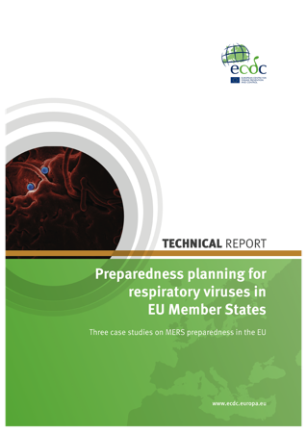
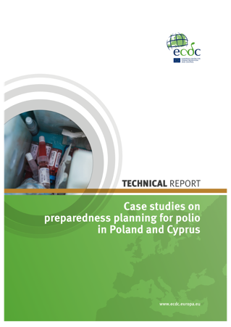
DRAFT
Health Emergency Preparedness Self Assessment Tool
DRAFT
ECDC Technical Document:
Conducting critical incident reviews to enhance preparedness planning
Notes:
Health Emergency Preparedness Self Assessment Tool
Conducting critical incident reviews to enhance preparedness planning
Climate change and communicable diseases in the EU Member States - handbook for national vulnerability, impact and adaptation assessments

Slide 18


travellers
VHF pathways and potential responders: conceptual scheme
medevac
Cross-cutting
Surveillance
Case finding
IPC
Laboratory
Info, comms
HR, training
coordination
Point of entry
Aircraft
Border check
community
disembark
contacts
Public Health
symptomatic
asymptomatic
transport
IPC at border
transport
112
ambulance
PHC
Designated treatment hospital
Emergency dept.
Five modules
A – Primary responders
B – Point of entry
C – Medevac
D – In country transport
E – Designated hospital
Critical abilities
Isolation
PPE
Samples
Waste
Post-mortem
…..
For each organisation
Suspect case recognition
Patient management & staff protection
Plans & preparation
21 days
Possible point of recognition as suspect case

Slide 19
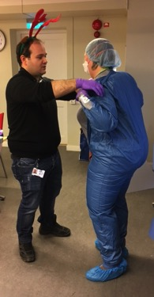
ECDC activities in the area of public health preparedness - 2017
    Support EU MS and EC on implementation of 1082
    Handbook on preparedness competences and training curricula
    Training on bio risk and mitigation (June 2017 in Budapest)
    Cross sectorial Simulation exercise (November/December 2017)
    Case Studies on community preparedness
    Collaborate with EC to analyse preparedness planning
    (art 4/decision 1082 reporting, including IHR)
  Develop instruments and share good practices (meetings and guidance)
    Risk ranking (guidance) (meeting in February 2017 in ECDC)
    Critical incidence review (guidance/compilation of good practices) (meeting in March 2017, RKI, Berlin)
    Annual NFP meeting (in collaboration with response and threat detection experts, EU MS + enlargement and some ENP countries). (May 2017, in Stockholm)
    Self assessment tool – Health Emergency Preparedness Self Assessment (HEPSA)
    Strategic guidance for preparedness planning (meeting in April 2017, RIVM, The Netherlands)

Slide 20
Institutional vs community preparedness
“the ability of communities to prepare for, withstand, and recover — in both the short and long terms — from public health incidents” (Nelson et al. 2007)
public health emergency preparedness (PHEP) includes public engagement
(educating, engaging, and mobilizing local social networks within the public domain to be full and active participants)
Improving the cooperation between public health institutions and civil society in preparing for public health threats
  Phase I: Theoretical contextualization of community and Institutional preparedness in Europe and globally
  Phase II: Empirical data gathering through country case studies
  Phase III: Developing guidance on how to integrate (more) effectively community preparedness into the PHEP cycle.
A. Context
A.1. Existing relationships and trust
A.2. Existing community organisation
B.1. Planning to support community preparedness
B.2. Mainstream community groups
C. Process
B.3. Community ownership
C.1. Initiation
C.2. Engaging community leaders
C.3. Communicating with communities
C.4. Engagement activities
C.5. Engagement timeline
C.6 Engaging vulnerable community groups
B. Infrastructure
Notes:
We want to identify what worked in which contexts, paying special attention to practices and patterns of effective cooperation between community and institutional preparedness. The effectiveness of this cooperation can be measured by the level of integrating communities into the preparedness cycle: whether they are involved in planning/organising/training/exercising/evaluating preparedness

Slide 21



Slide 22
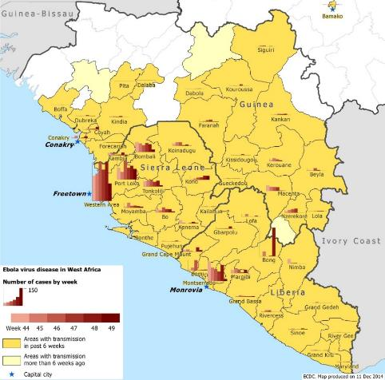
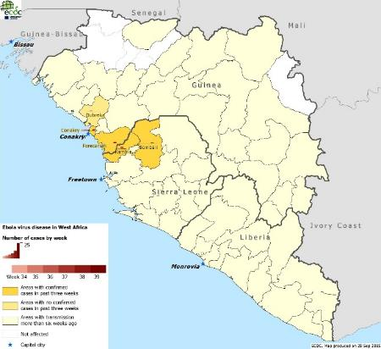
Support during and after public health emergencies
In EU
On site
Alert phase
  Assessment of MS status on preparedness in regards to Travel, infection control, biosafety, early detection, Medevac
  Guidance for safe handling of patients
  Country peer review visits
  Training on biosafety for frontline staff
  Organisation of Simex
  Risk assessment in support to HSC coordination of Preparedness and response
  Review of country capacities/capabilities through self-assessment
Response
  Advice on Clinical care, through clinical/ITU/lab networking
  Emergency Risk Communication support
  Enhancing of ECDC PHE management through EOC
  Assistance to EC on joint procurement for PPE
Recovery
  Post event reviews and lessons learning workshops
Alert phase
  Rapid risk assessment, through an expert team defining a response strategy
  Rapid need assessment, through an expert team identifying/prioritising needs and gaps
Response
  Clinical care, through NGO’s and institutions establishing treatment units or reinforcing healthcare facilities – link to Emergency Medical Teams;
  Laboratory activities, standalone “mobile laboratories” or support to local laboratory;
  Public health surveillance and response to support local public health teams.
Recovery
  Transition teams, through an expert team drawing lessons and defining a transition strategy

Slide 23
Blind spots for capacity building and operational research in PHEP
How to enable the generation of real-time evidence (clinical, epi, anthropological)? E.g. multi-discipline network/platform in “peace time”
How to address gaps and strengths of PH systems preparedness (capacities-capabilities) to develop competencies of management and frontline staff
How to facilitate cross-sectorial, cross-border lessons learning from response/recovery – to address the gap that not much learning happens from crisis to crisis
  Community and participatory approaches to preparedness (which resources, networks, or types of local ‘lay’ expertise exists and can be accounted for?)
  Not everyone is equally at risk – where is vulnerability?
  How can flexibility be designed or accounted for in preparedness planning
Notes:
Evidence based preparedness (including flexibility and recovery planning)
Capacity building
Evaluation

Slide 24
ECDC contribution to health security
Prevention
Preparedness
Early warning
Surveillance
Outbreak
Response
Assistance
Recovery
Scientific research and guidance
Health determinants
Prevention guidance (AMR, VPD)
Risk communication
National risk assessments > preparedness priorities
Preparedness plans
Inter-operability of plans
Intersectoral collaboration
Training & Exercising
Crisis management procedures
COOP plans
Evaluation
Epidemic Intelligence
Risk Monitoring
Rapid Alert
Risk Assessment
Public Communication
EU Surveillance
Support to Risk
Management
Outbreak
Communication
Guidance on rehabilitation/ decontamination
Crisis Mgt and Response Evaluation
Lessons identified > case studies
Update detection/response protocols
Outbreak investigation
Mobilisation of networks
Deployment of OAT
Prevention
Preparedness
Response
Recovery

