Slide 1
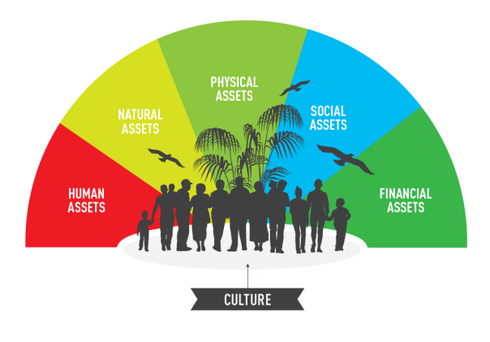
CULTURE & DRR: NO ONE LEFT BEHIND
Cultural Knowledge in DRR
= Successful Programs

Slide 2
The Power of Culture
Every human group and human being is influenced by cultural factors that shape their decisions and viewpoints.

Slide 3
Culture Influences Viewpoints

Slide 4
Culture influences DRR uptake
Understanding cultural context, traditions, and values can make all the difference in whether DRR initiatives are accepted and applied.

Slide 5
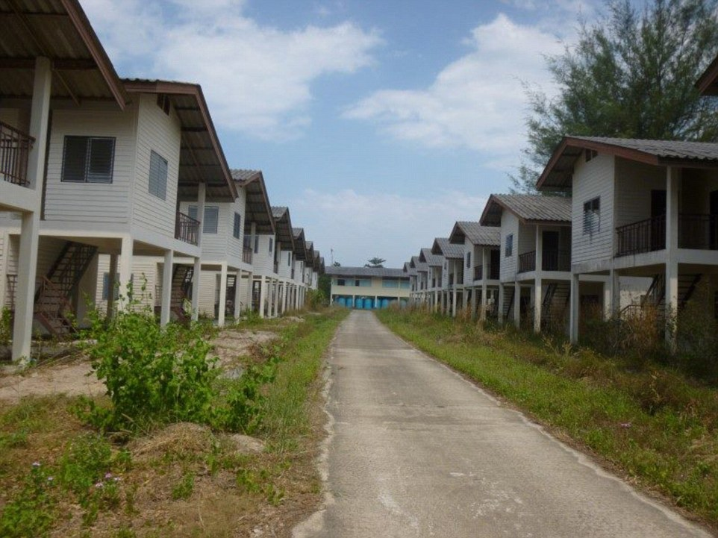
ABANDONED
DDR FAILURE
LIONS VILLIAGE, KOH PHRA THONG
ISLAND, THAILAND
Limitations of Traditional DRR Approaches:
This fishing village, rebuilt after the 2004 Indian Ocean tsunami, today stands empty because structural and legal mitigation measures were given priority over local cultural considerations and local residents were not consulted.

Slide 6
Today, DRR Specialists Agree:
“Culture is important”
But how we are defining it?
What is Culture?

Slide 7
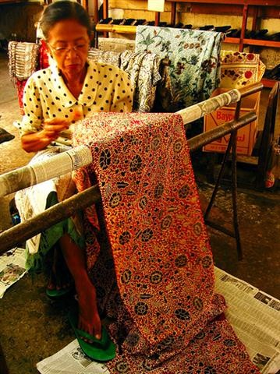
“CULTURE AS A SECTOR”
= RECENT APPROACH TO DRR:
What is Culture?
Built heritage & cultural/ natural site
Cultural goods as industry and livelihood source
Expressions of cultural heritage
Movable property
Heritage repositories
Haiti, 2010

Slide 8
Culture is more than a sector.
Culture cannot be bound by what is visible, audible or material. It is not discrete from other parts of life.
Limitations of Culture as a Sector

Slide 9
Understanding Culture

Slide 10
Understanding Culture
Culture permeates, shapes, and defines the physical, economic, and social environment.

Slide 11
Culture-Based DRR
WHAT IS CULTURE-BASED DRR?
With a culturally-based DRR approach, proven models, strategies, templates, and best practices serve as starting points that are then adapted to match the specific cultural system in a particular location.

Slide 12
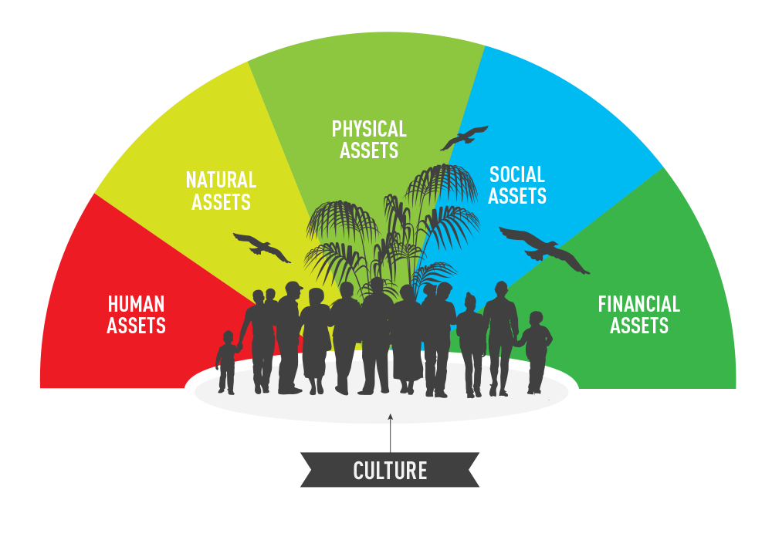
Culture-Based DRR

Slide 13
Culture-Based DRR
A CULTURALLY-INFORMED APPROACH
Culture-based DRR focuses on the shared understandings that underlie how communities perceive and respond to risk and recover from disaster.

Slide 14
Culture-Based DRR
CULTURAL KNOWLEDGE = SUCCESS
Culture belongs at the center of designs for Disaster Risk Reduction (DRR) policy and programs.

Slide 15
WHEN CULTURAL ANALYSIS IS INTEGRATED IN PROGRAM DESIGN…
Culture as Success Factor

Slide 16
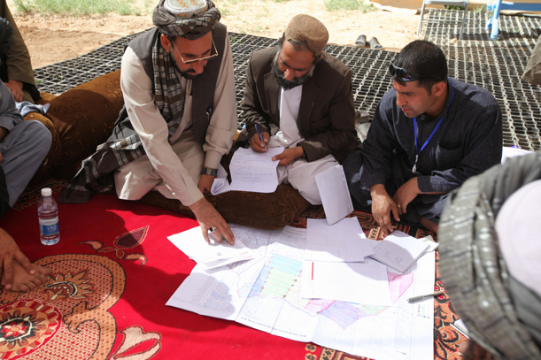
AFGANISTAN:
FOOD SECURITY/ DROUGHT RECOVERY/DRR

Slide 17
We found:
Accept assistance -- not charity
Fiercely proud and self- sufficient
Importance of capacity to make decisions
Pride in agricultural knowledge
Social economic networks: farmers/suppliers/buyers
Community understanding of local need
Community-based decision-making structures
Culture as Success Factor

Slide 18
Program:
Agricultural vouchers and technical support
Application – not universal
Criteria developed with community – applied by community
Co-pay 15% requirement
→ownership, →self-sufficiency, →not charity
Any mix of inputs
→Dignity of individual decisions, respect local expertise,
→household level needs
Pooled resources – i.e. mini-tractors
→ local collaborative structures
Local suppliers
→retain local economic relations
→sustain local market systems
Training on demand
→Value of choice, respect local expertise
Culture as Success Factor

Slide 19
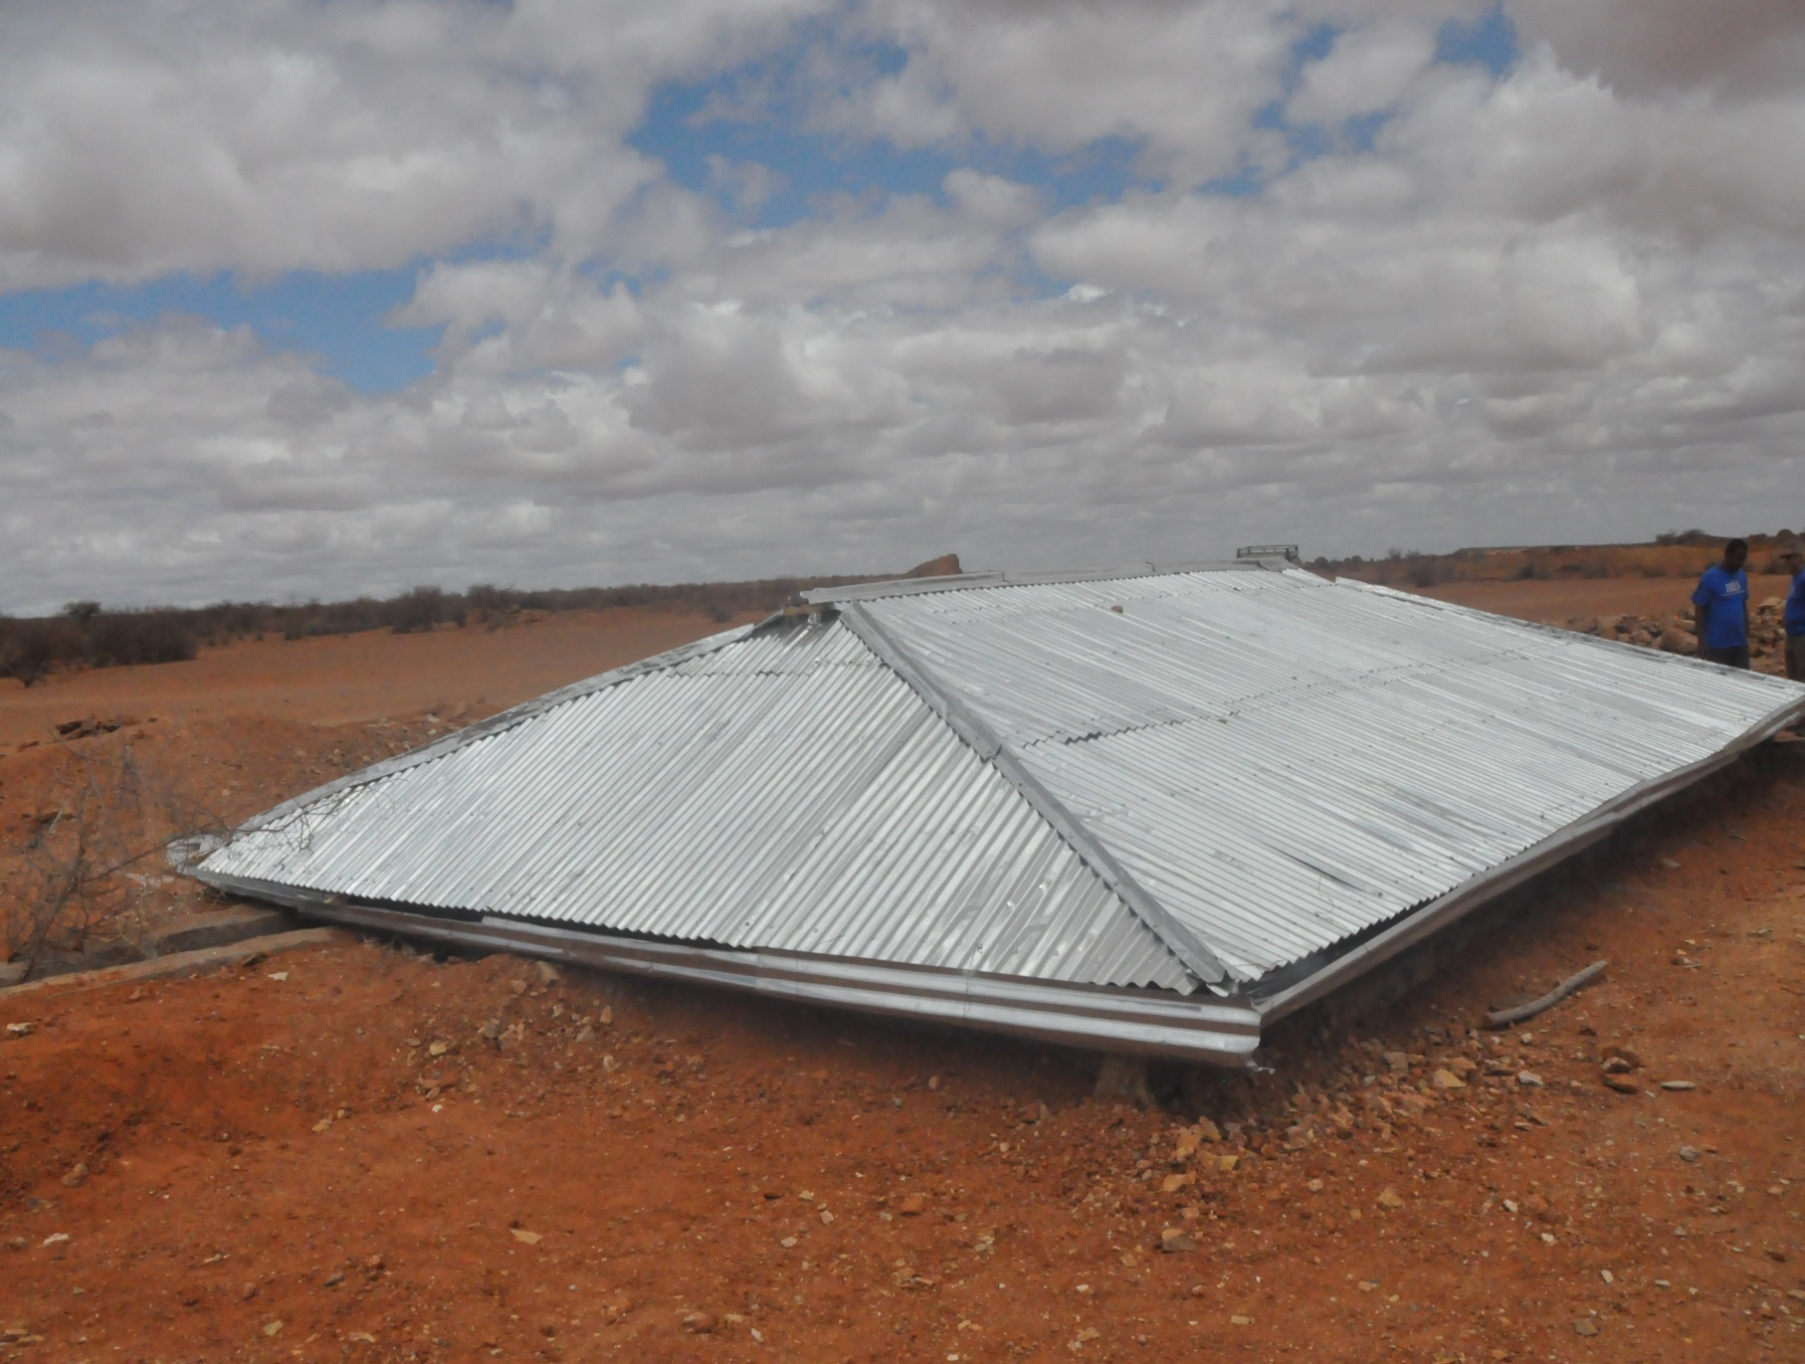
ETHIOPIA:
DROUGHT DRR
WATER ACCESS

Slide 20
We found
Traditional community-level water technology
Traditional water management and rationing
Traditional structures in disrepair ……….
Replaced by “modern” externally introduced tanks
Culture as Success Factor

Slide 21
Program
Rebuilt traditional technology
community voluntary labor
→ ownership and pride
Used local strategies for water management
→respect for local solutions and technology
Improvements did not change familiar technology
larger, stronger, more durable
more efficient – prevented evaporation
more sanitary – prevented animals and debris

Slide 22
WHY INTEGRATING CULTURE IS SUCH A CHALLENGE
Narrow cultural definitions
Time pressures
Perceptions of pre-existing cultural knowledge
Complexity of culture
Existing DRR “package;” generic best practices
Adhesion to existing rigid DRR policies
Hidden cultural assumptions of DRR organizations
Barriers to Uptake of Culture-Based DRR

Slide 23
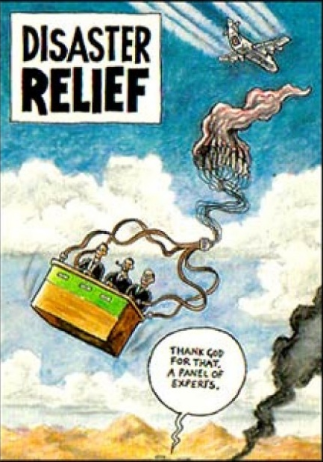
Organizational Culture also Impacts Aid Efforts

Slide 24
HOW CAN WE INCREASE SUCCESS
BY INTEGRATING CULTURE INTO DRR ?
Identify and build upon existing effective models
Appropriately tailored data collection methods
Culturally-sensitive analyses
Build culture analysis into policies/strategies
Devote attention to local partnerships
How To Integrate Culture

Slide 25
CADAN--Culture and Disaster Action Network
Contact us!
cadan@colostate.edu
How To Integrate Culture
Contact us!

