Slide 1

Nobuyuki Asai
Soka Gakkai International

Slide 2
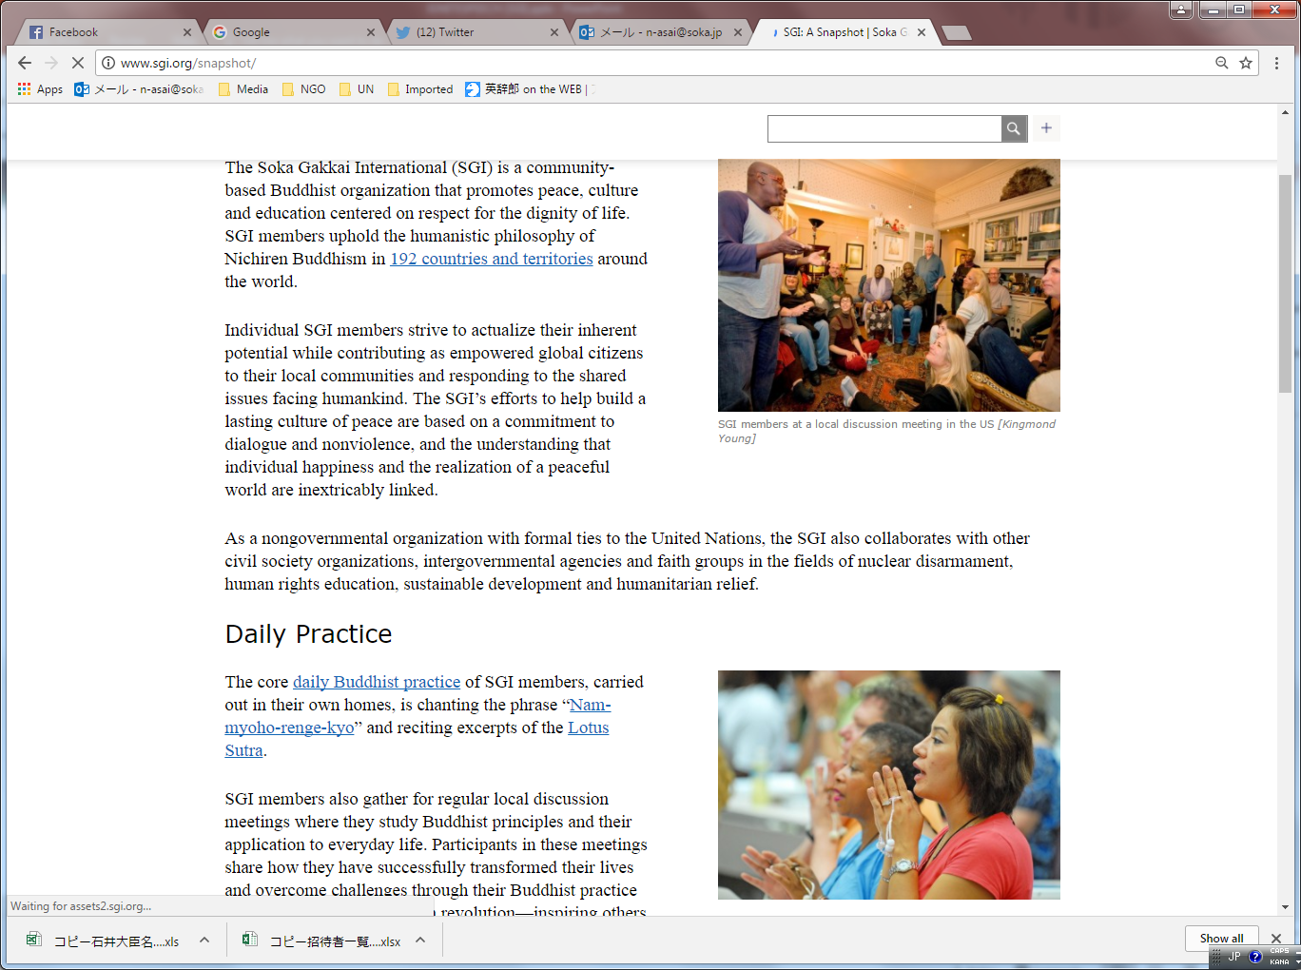

Slide 3
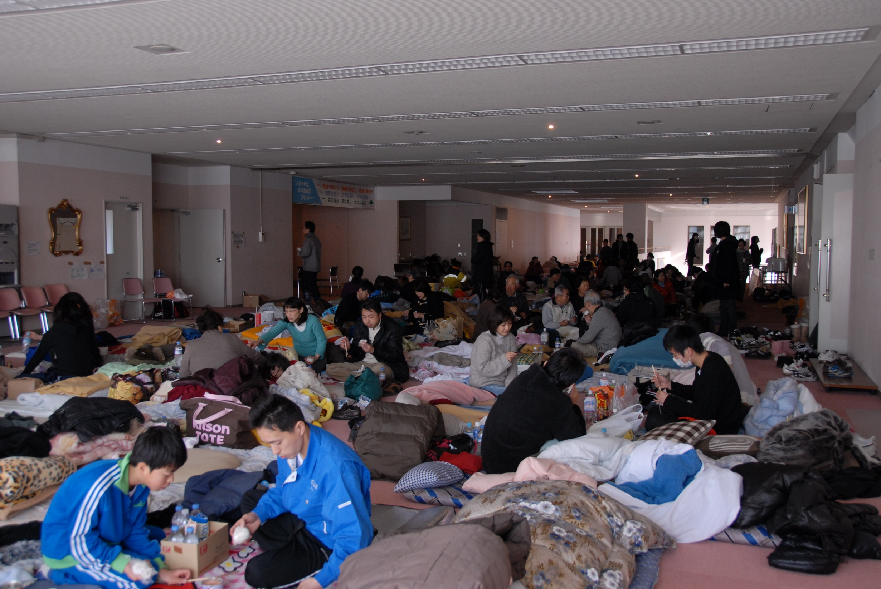
SGI’s community centers accommodated thousands of evacuees.

Slide 4
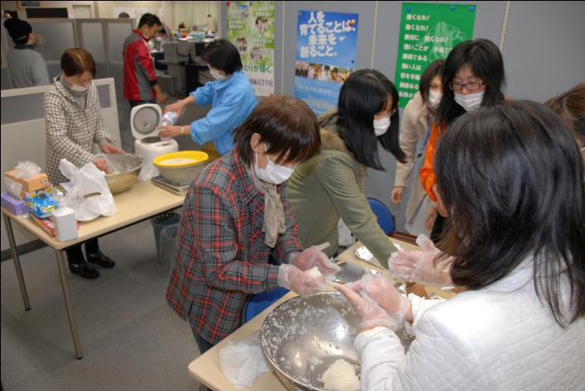
Many individuals volunteered to run the shelter.

Slide 5
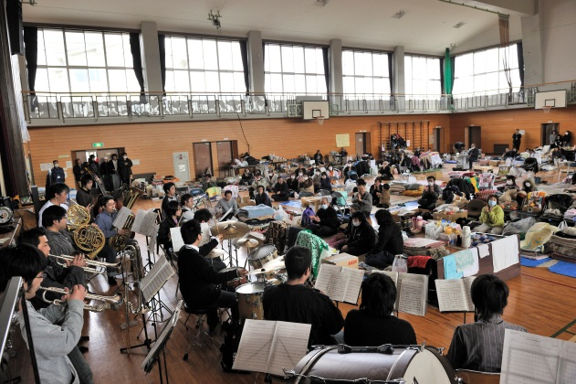
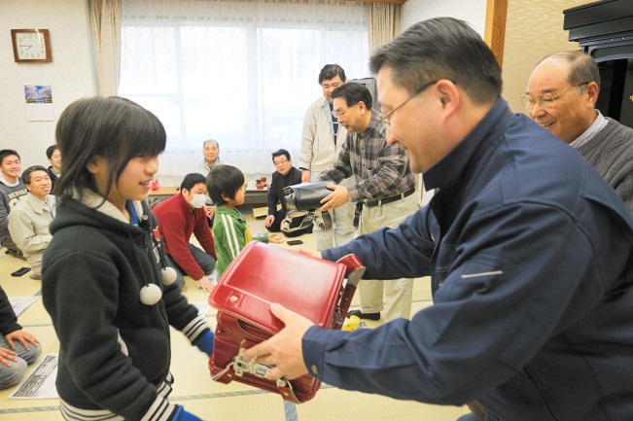
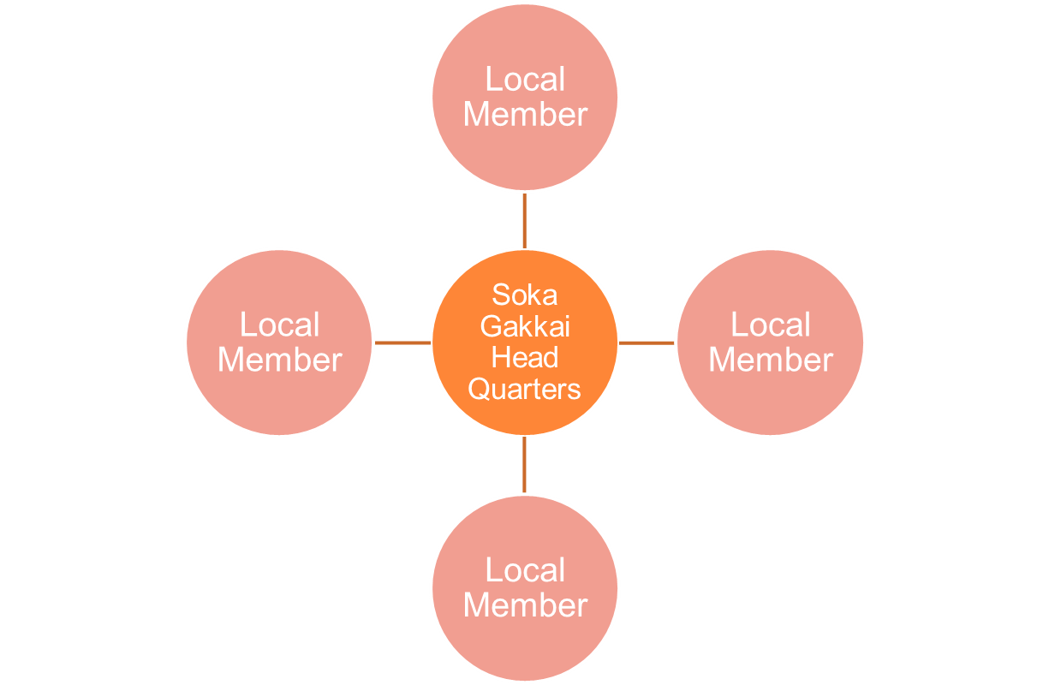
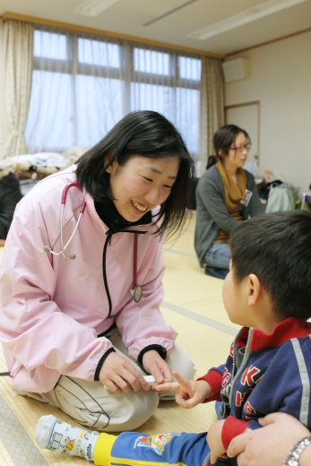
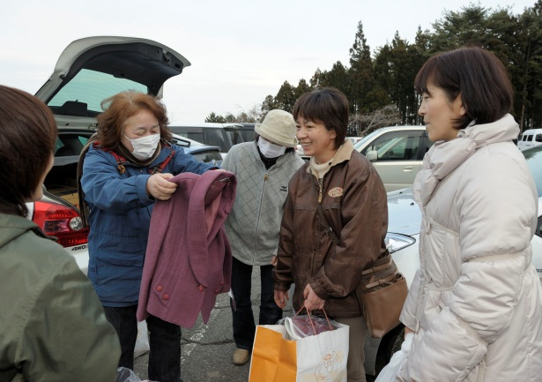
Network of individuals built through daily religious activity

Slide 6
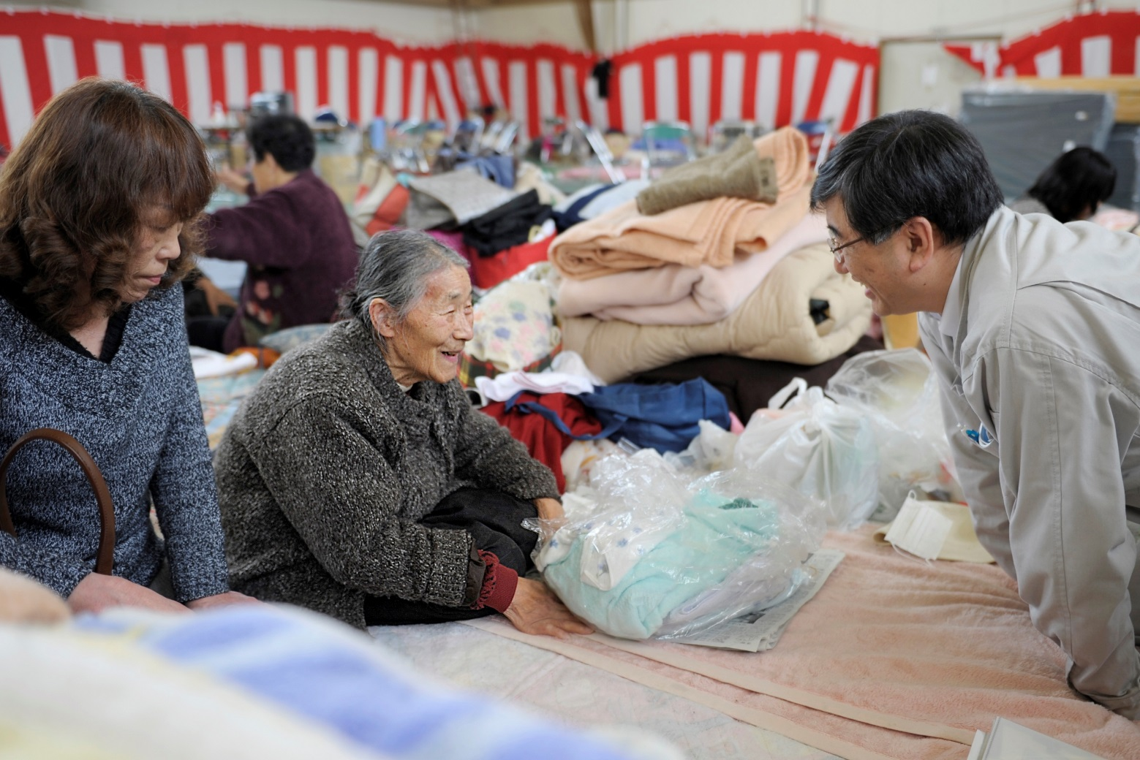
At public shelters SGI members often volunteered to run them as well.

Slide 7
Recovery phase

Slide 8
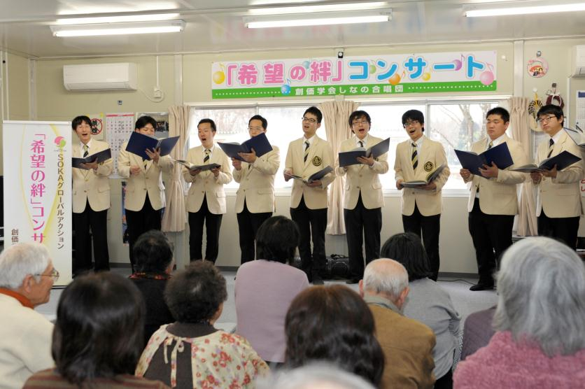
Concert series
“Building Bonds of Hope”

Slide 9
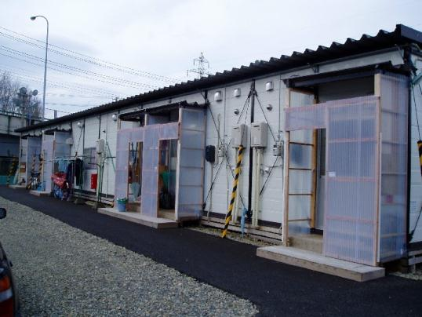
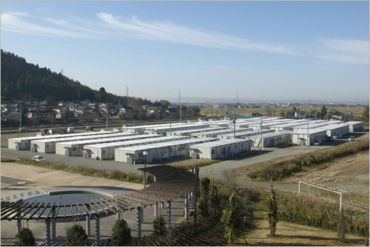
Temporary housing

Slide 10
Preparation phase

Slide 11
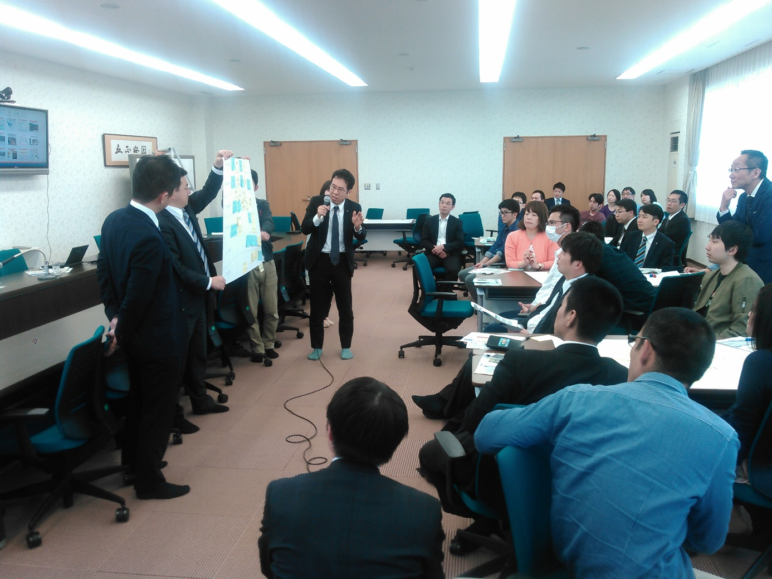
Workshop for preparation for a huge disaster

Slide 12
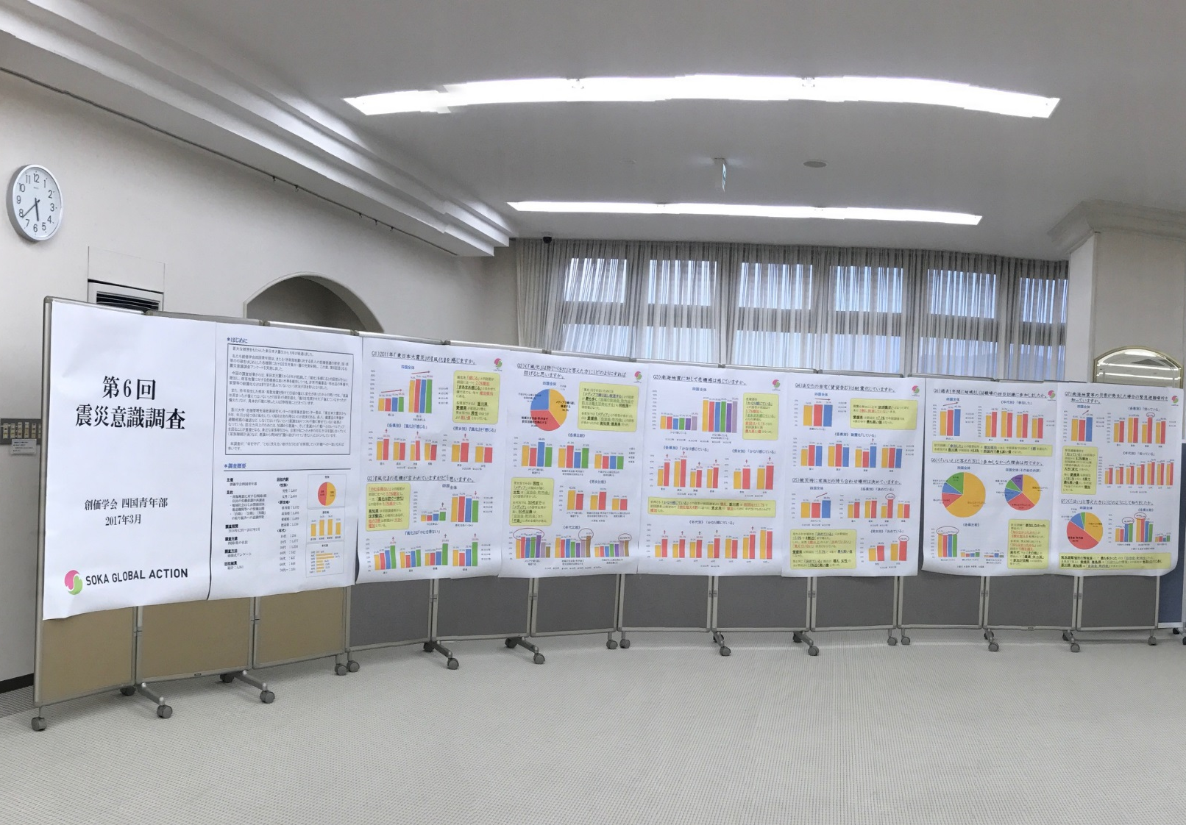
Shikoku region members have conducted awareness survey with around 5,000 respondents past five years.

Slide 13
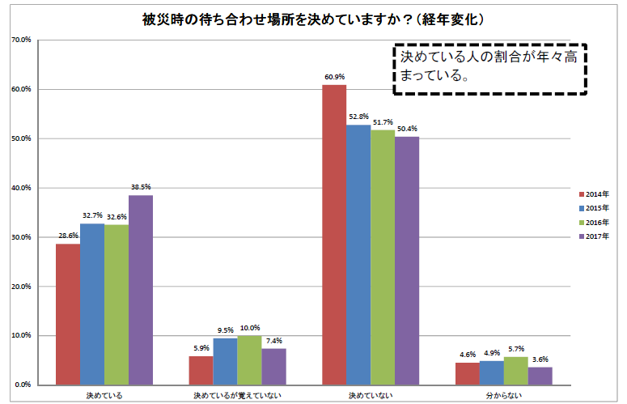
“Have you chosen a place to meet with family members during emergency?”

Slide 14
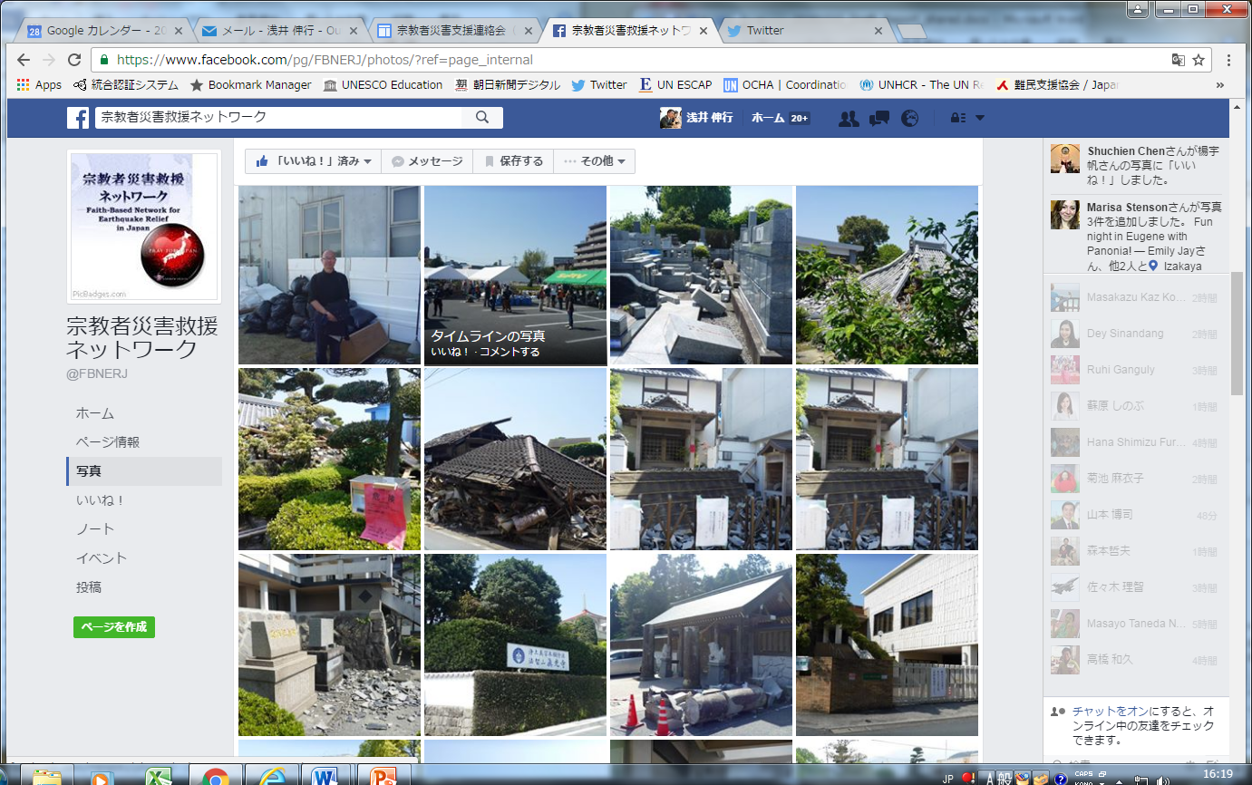
Japan Religion Coordinating Project for Disaster Relief

Slide 15
SGI’s commitment in 2017GP
- At the Market Place, SGI’s booth will be at C2, titled “Japanese FBOs’ contribution to DRR.”
- SGI will deliver an Ignite Stage presentation with the title of “Engaging private citizens in DRR” from 5:45pm of 24th.

Slide 16
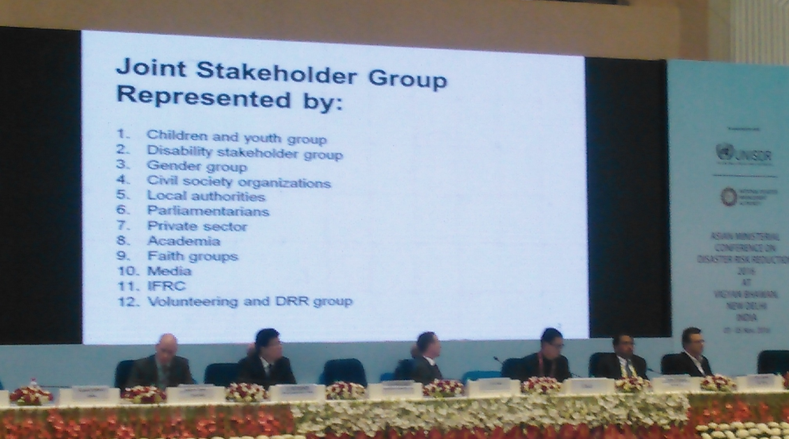
The 6th Asian Ministerial Conference on DRR held in Delhi in Nov. 2016

Slide 17
Thank you very much!
www.sgi.org

Slide 18
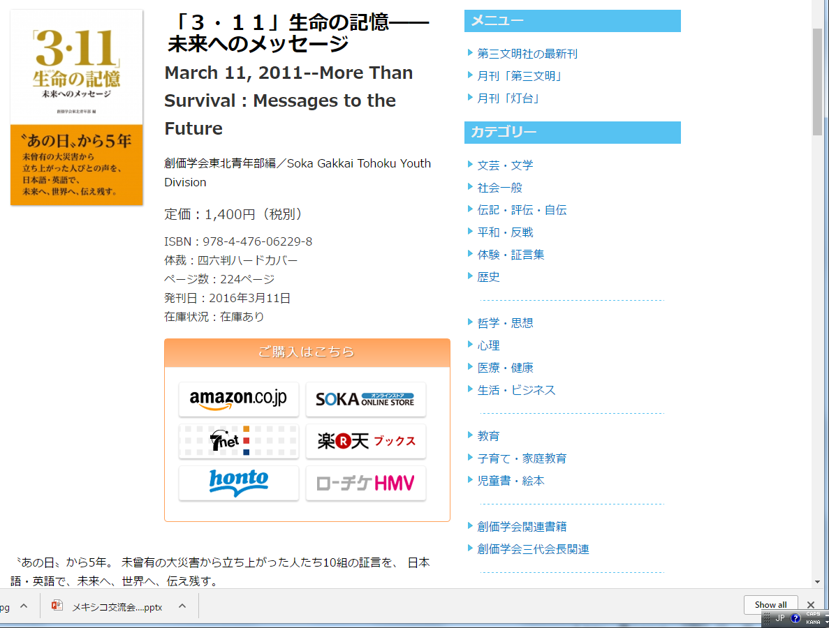
Concert of the Shinano Men’s Choir

Slide 19
Soka Gakkai International
Emergency evacuation shelters that were safe and stocked with relief supplies
Regular interactions within the network of people rooted in the community
Emotional encouragement
Involvement of youth

Slide 20
“Disaster victims are not weak people despite living every day in harsh conditions. I know that they have strength within themselves. They have the potential to engage in relief activities.”
A local Soka Gakkai leader in Miyagi

