Slide 1
Earthquake aftershock forecasting
and humanitarian response
Lessons from Nepal

Slide 2
THE SCIENCE OF
AFTERSHOCK FORECASTING

Slide 3
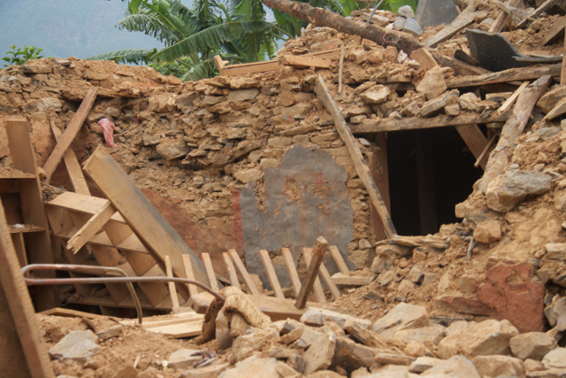
AFTERshock forecasting
Earthquakes can’t be predicted
However, aftershocks follow robust seismological ‘laws’
Probability of aftershocks of certain sizes
Where they are most likely to occur...
Notes:
Although earthquakes can’t be predicted, aftershocks are more amenable to forecasting as they follow certain robust seismological rules
These rules give us an ability to determine the probabilities of aftershocks of certain sizes, within certain time windows
We can also indicate roughly where they are most likely to happen
I would like to introduce these laws

Slide 4
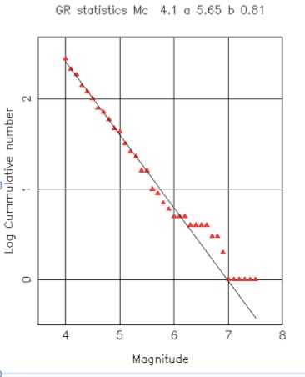
Gutenberg Richter law
Relationship between magnitude
and total number of earthquakes
You get more small aftershocks than big ones
Notes:
G-R law shows the relationship between magnitude and total number of earthquakes – basically you are more likely to get small aftershocks than big ones, which is not to say that you won’t get big ones, and we must remember that it is possible for an aftershock to be bigger than the main shock.
The graph shows real data from Nepal – you can see how the cumulative number of aftershocks of different sizes are plotted on this graph, and a clear trend emerges which can have a best-fit line drawn – this is important as it can be used to derive the probabilities of aftershocks of different sizes

Slide 5
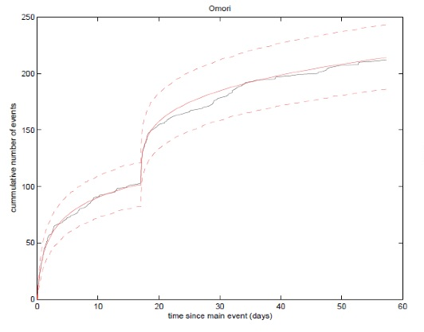
Omori law
Number of
aftershocks
decays through
time after a
mainshock
Notes:
Omori law shows how the number of aftershocks decays through time.
This graph shows how the cumulative number of aftershocks was levelling off when the large aftershock on the May 12th struck – which has its own aftershock sequence, hence the double curve. This information allows the probabilities to be placed in time, and thus creates a forecast.

Slide 6
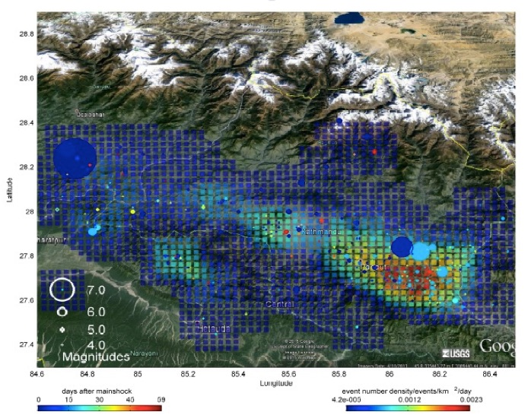
“There will be further aftershocks, likely to concentrate in an area 50-100km radius of the M7.3 epicentre”

Slide 7
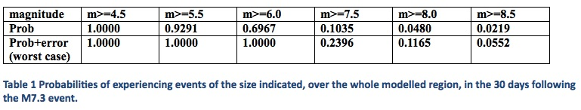
Putting it all together: 15th May 2015
“We should expect aftershocks that are up to a M 6
and there might be an aftershock up to M 7.5”
Notes:
The table shows the information we received from the team in the University of Edinburgh. It shows that for the 30 days after the May 12th event, there was a 70% to 100% likelihood of M6 aftershocks, and events as large as M7.5 came with a probability between 10 and 23%. Far too high to ignore.

Slide 8
USING THE FORECASTS

Slide 9
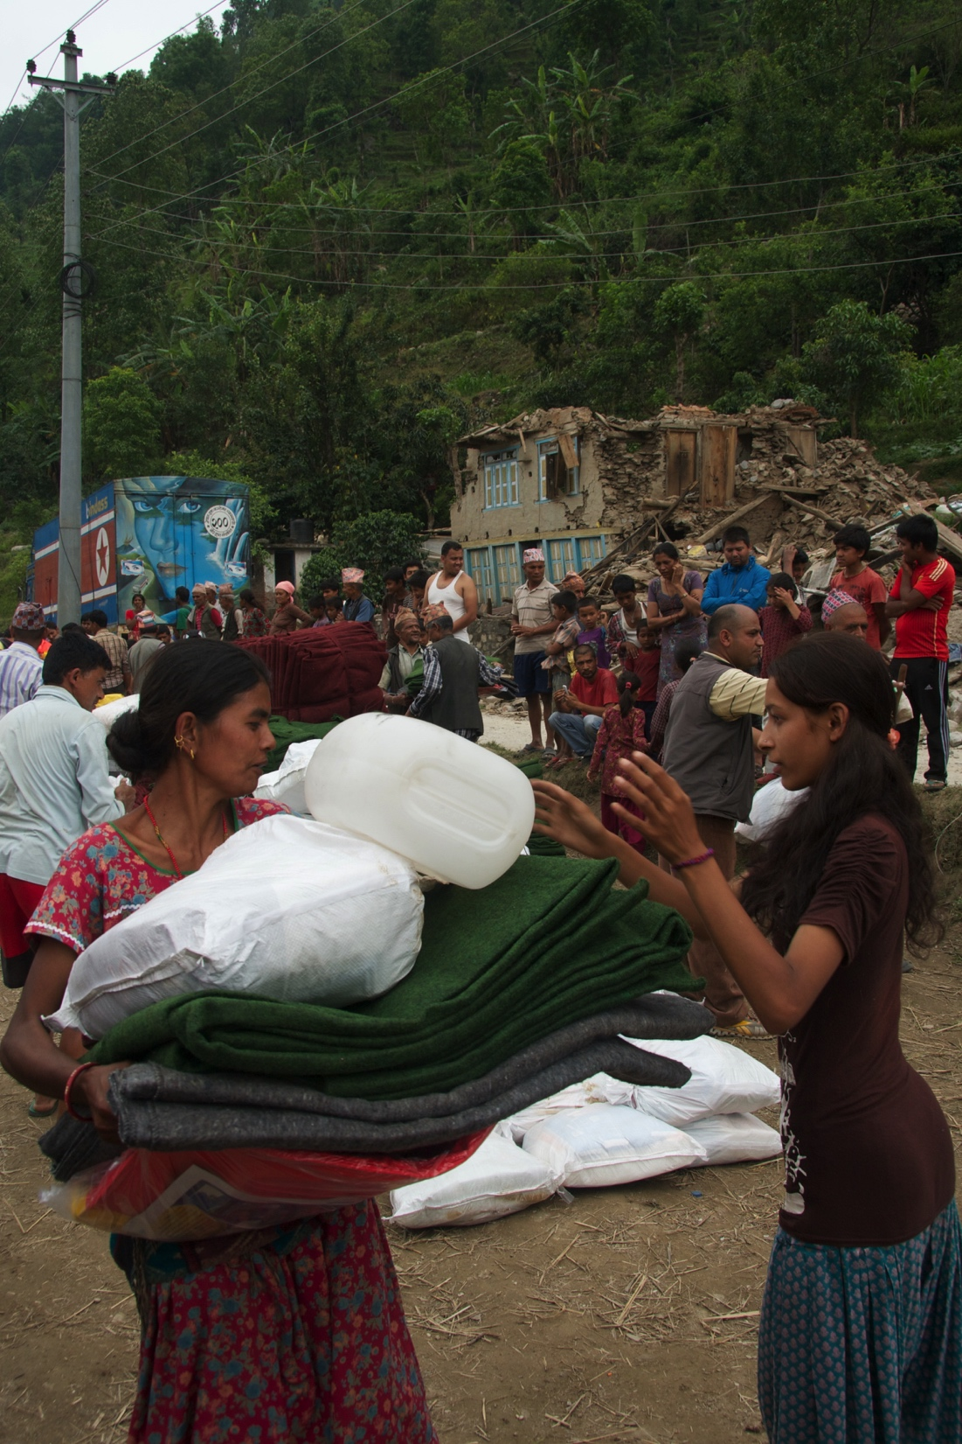
The Concern earthquake response
Rural Reconstruction Nepal (RRN)
Nepal Water and Health (NEWAH)
14,000 ‘household kits’
  Tarpaulin,
  Sleeping equipment,
  Hygiene items,
  Jerry can
Water supply and latrines
Notes:
This is what we did as a response

Slide 10
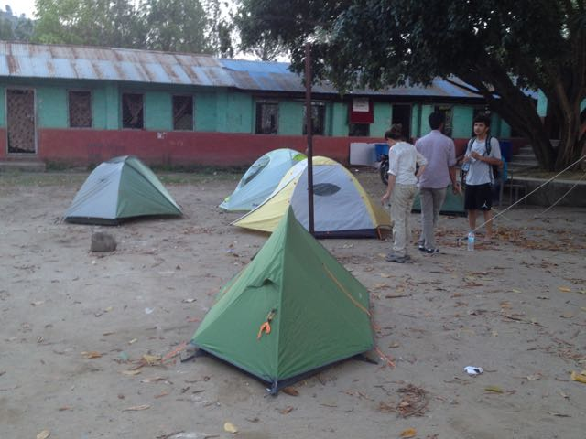
Safety of all staff
In rural areas
Buildings, Steep slopes and Emergency gear
In urban areas
Roofs and muster points
Everyone, everywhere
Whistles and grab-bags
Notes:
Recognising the risks of further aftershocks made us focus on staff safety – making tents and whistles available to all, including partners, making sure all vehicles had emergency supplies in them, sleeping in as safe as possible conditions in town...

Slide 11
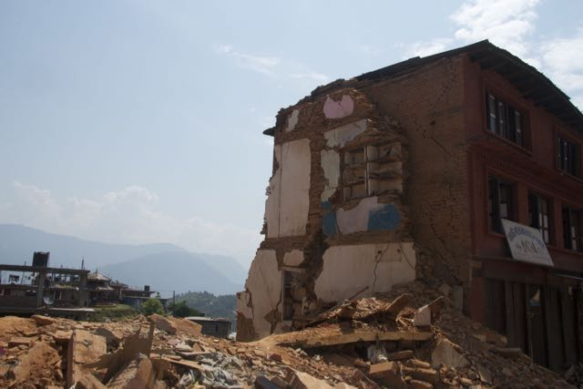
Safety of earthquake affected population
NO going back into buildings yet – even if they ‘look’ safe
Ignore people who suggest it is OK to move back inside; they are wrong
Notes:
Messaging to the populations

Slide 12
Better programming decisions
Leave dangerous places till last
Keep away from steep / unstable slopes (landslides)
We can be confident
Notes:
Confidence that in spite of conflicting information we have access to believable info that can help us to nuance our work.
Had we not been in the most active zone we would have launched an information campaign urging people not to be indoors until the risks diminish

Slide 13
Weaknesses
More data, faster data → faster and better forecasts
Communicating probabilities: prior training required
Notes:
The better the data the better the forecast – OK in Nepal, wouldn’t be OK in Afghanistan
Need to understand probabilities and aftershock science to be able to make decent decisions – training needed

Slide 14
Where we go from here
Identifying and training influential decision makers
Improving the earthquake catalogue
Notes:
This is what we will focus on going forwards – who wants to receive the training?
Accelerometers in phones / rapid deployment of seismometers...

