Slide 1
Survivor/Community-led response. From goats to agent of change!

Slide 2
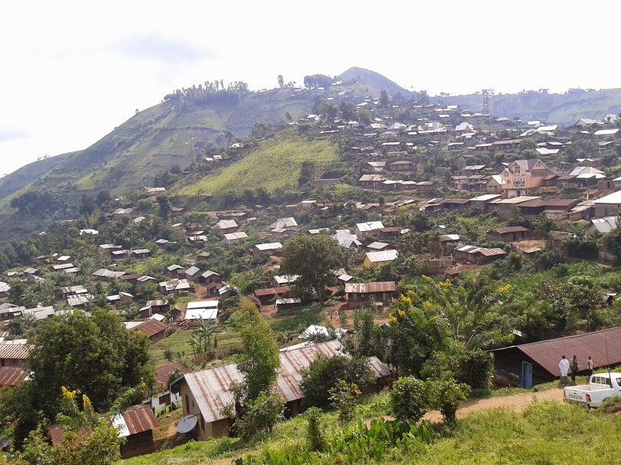
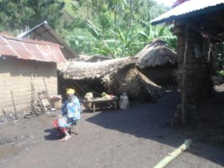
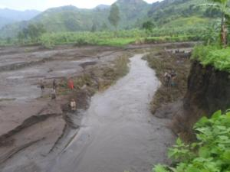
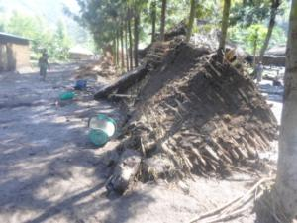
Notes:
CA had a DFID funded resilience programme for 2011-2016 in North Kivu DRC and other 6 countries
We have worked with our local partner CBCA in a village called Bweremana. To strengthen community resilience to natural and man made disasters.
After 3 years the villagers were empowered and organised to manage their local risks
On 5th of October 2014 a significant landslide fell on the north side of the village. The consequences were 3 people dead, 45 injured, 50 houses destructed and significant impact on agriculture.
On the 6th of October I had a need assessment on my desk in London compiled by the Village development committee together with CBCA. Very accurate including reconstruction of houses and bridges, NFI and livelihood.
CA didn’t have funds available to support so we broker a response from another agency who normally work directly also working in the area.
This agency went to the village without informing our partner, the VDC and went straight to the affected area. Conducted a needs assessment with the affected families. After `15 days they came back and delivered the response. WASH and tools. Significantly different from the community needs assessment. The evaluation of the response was of course perfect. Once I’ve asked why they chose those items the reply was that they had money for those. Full stop.
Villagers of course were grateful. But also felt betrayed
But it was a missed opportunity!
This example shows how the DRR/development are disjointed with humanitarian work leading to inefficiencies and undermining community agency.
Humanitarian is more top-down, externally led, over technical and with a narrow focus on individuals, saving lives and meet basic needs. DRR/development have opposite aims, it’s about collective action and empowerment.

Slide 3
What are the characteristics of community-led responses when external aid is absent (i.e. what are the positive and negative actions of local people during a crisis when there is no external support)?
People depend more on each other, self-help, local resources, local ideas
Multiple community groups want to manage their own multiple, holistic responses...but are limited by lack of resources
People do not separate “humanitarian”, “protection”, “development”, livelihoods etc
Greater focus given to livelihoods and longer term recovery and even root-causes
Importance of social, cultural, dignity and non-material needs (psychosocial)
Efficiacy of many (not all) local knowledge and processes
Knowledge and information are not evenly distributed
And of course neither is power or capacity...complex exclusion/inclusion issues (gender, ethnicity, social status, age, health)
Notes:
Highlight the psychosocial aspects
Make participants discuss over a topic:
Flag the psychosocial element (faith, passion, belief etc). research has shown survivors needs to be listened in terms of priorities, such a perfume. ‘people are not goats, they need more than food and water’ (LPRR pilot participants)
Power imbalances can be reinforced
Highlight the ‘heroes’, the ones that are standing and doing something about their condition. They come up spontaneously, but we need to find them
Local expert (local knowledge) exists, especially in recurrent crisis. They know what to do.
Build on social networks
Make people note that most point raised are positive and this make people open their eyes
Flag the transformative element of crisis. For example, gender roles (can be positive as well as negative). Make them discuss

Slide 4
What do crisis affected people think of externally-led humanitarian assistance?
First and foremost, appreciation of scale, scope, intention and often critical life-saving nature of assistance
But, frustration with tendency to be:
less responsive (to local needs & opportunities)
slow to start
quick to leave
less cost effective
poorly coordinated
at times divisive
Insensitive, degrading
ignoring local ideas, knowledge, capacity
Over time can promote learned helplessness, dependency
Can reinforce unhelpful power structures

Slide 5
Notes:
The classic needs assessed by humanitarian response are mostly in the realm of biological and material. In conflict we can see bits of mental
DRR/resilience/development are more able to engage in the other aspects of wellbeing.

Slide 6
‘ community members are not like goats, they need more than food and water to survive’ LPRR co-design workshop participants (2017)
Notes:
We treat people as agent of change in DRR/development but as goat in response!

Slide 7
LPRR: how can humanitarian response strengthen community resilience? From theory to practice
Notes:
With the experience of Bweremana in mind CA and other 6 humanitarian agencies worked with KCL to answer the question on how humanitarian response can build or not undermine community resilience. How we can better plug our external responses into local processes?
Part of the LPRR project funded by DFID-DEPP

Slide 8
Research= literature review!
The KCL literature review identified two gaps in existing research:
A lack of knowledge that focuses on ASKING SURVIVORS AND FIRST RESPONDERES their recommendations
A lack of systematic implementation and evaluation of practical recommendations
Additionally the resilience lenses allow us to put more emphasis on the community capacities and in particular on the opportunities for transformation created by the disasters
Notes:
One key benefit of working with KCL was their role of critical friend.
First step they conducted a literature review. This pointed us to a focused research question and methodology

Slide 9
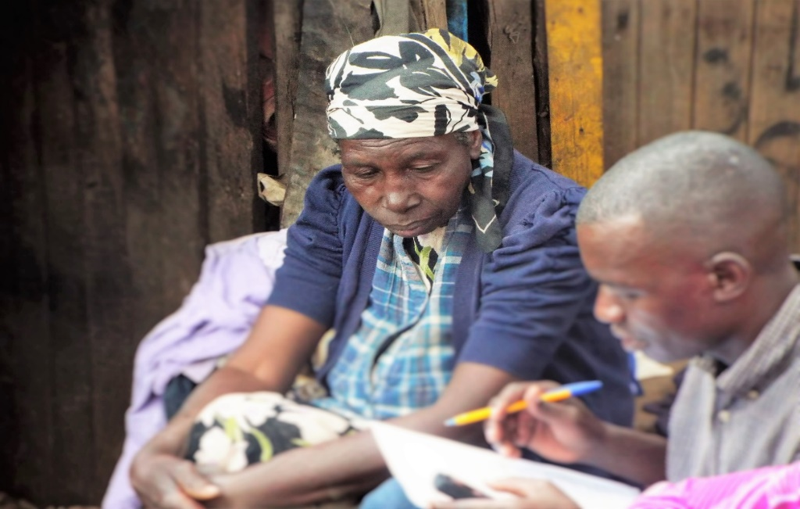
The LPRR Study’s Aim
To capture the recommendations and perceptions made by local stakeholders (first responders and crises survivors) for how humanitarian response can be strengthened to enable (and not undermine) long term community resilience building.
Notes:
Led by KCL with a resource shared between KCL and CA/LPRR
This paper draws upon and takes forward the existing Linking Relief and Development Debate (LRDD) and
acknowledges the fact that for decades, academics, practitioners and policy makers alike have grappled with how to
better align humanitarian aid and longer term development. Reflecting on the challenges mapped out by the
continuum and contiguum theories, this paper supports Macrae’s (2012) argument that resilience offers a new
opportunity to bridge the gap and better align interventions.
What is new? What is our contribution to the debate?
Recent calls to re-open the debate and apply research to understand how resilience can offer the answer this
ongoing debate has inspired this LPRR project and study.
The LPRR project identified two gaps in existing research:
A lack of knowledge that focuses on asking crises survivors and first responders their recommendations
A lack of systematic implementation and evaluation of practical recommendations
Additionally the resilience lenses allow us to put more emphasis on the community capacities and in particular on the opportunities for transformation created by the disasters

Slide 10
The KCL Study
Location | Organisation | Hazard
Philippines, Manila | Christian Aid | Typhoon Ketsana
Philippines, Ormoc | HelpAge | Typhoon Haiyan
Kenya, Nairobi | World Vision & Concern Worldwide | Food Insecurity
Indonesia, Banda Aceh | Muslim Aid | Tsunami
Pakistan, Sindh | World Vision | Floods
Colombia, Cacarica | Christian Aid | Conflict & Displacement
Bangladesh, Patuakhali | Action Aid | Cyclone
DRC, South Kivu | Christian Aid | Conflict & Displacement
Notes:
Benefit of collaboration is KCL could study a wide variety of responses (context and different types of hazards) as well as operational models and in different times.

Slide 11
Perception of Resilience
The crises survivors felt that resilience meant both independence and support when needed.
“Resilience means having the skills and capacity to look after yourself whilst knowing how and where to ask for support when needed.”(LPRR Local Stakeholders)
Notes:
First is the local stakeholders’ perception of resilience.
In each individual case study and context the nuances were very different.
Doesn’t mean independence from government – but from us – outsiders, interventions

Slide 12
Bigger picture: what is this paper saying?
The learnings from this study speak to both the preparedness and humanitarian response phase of an intervention
It presents the recommendations made by crises survivors and first responders on what approach should be taken and what activities should be included to harness these opportunities.
If effectively operationalised, it is argued that this newly informed set of recommendations have the potential to bridge the gap between short term and long term interventions, align all phases of the disaster cycle and pave the way for transformational community resilience building.
Notes:
Then, reflecting bigger picture, remember that the paper and this presentation is speaking to both response and preparedness,
it presents local actors: crises survivors and first responders’ recommendations
If we are able to operationalise humanitarian preparedness and response in a way that addresses the six core themes – we think this this approach can bridge the gap between short term and long term interventions, align the disaster cycle and pave the way for truly transformational resilience building

Slide 13
LPRR 6 principles
Notes:
LPRR therefore advocates six themes:
These are not new or surprising, but the mix of these represent an important innovation.
We have to keep in mind that all 6 must be in place, we cannot pick and choose.
However these no regrets , although they speak to practice, they still are a little too high level for field practitioners.
When run through the consortia members and to SN members and despite being welcomed and inspiring , they all felt they require a lot of preparatory work and investments, so they are hard to be used in new emergency
We joined forces with Local to Global Protection who has been capturing community initiatives during crisis in the last 10 years and was moving to develop an approach to help humanitarian response to plug into local initiatives and we co-developed with local partners the survivor/community led response. Based on their expertise and capacities.
PILOTS LPRR 2017-18
Launched in Yangon & Nairobi
Piloted in Kayin & Rakhine Myanmar with Christian Aid Partners (KBC, DEAR Myanmar, MRF and BBS)
Piloted in Marsabit, Maralal and Isiolo Kenya with Christian Aid and CAFOD partners (PACIDA, MIONET, CIFA, Carita Marsabit, Mararal and Isiolo)
Each partner allocated a small grant for a pilot
There are many initiatives of this type led by national and local organisation. this is only one way of doing it. the important is for external organisation to recognise and begin participating in local self-started initiatives. Not force them to work with us,.

Slide 14
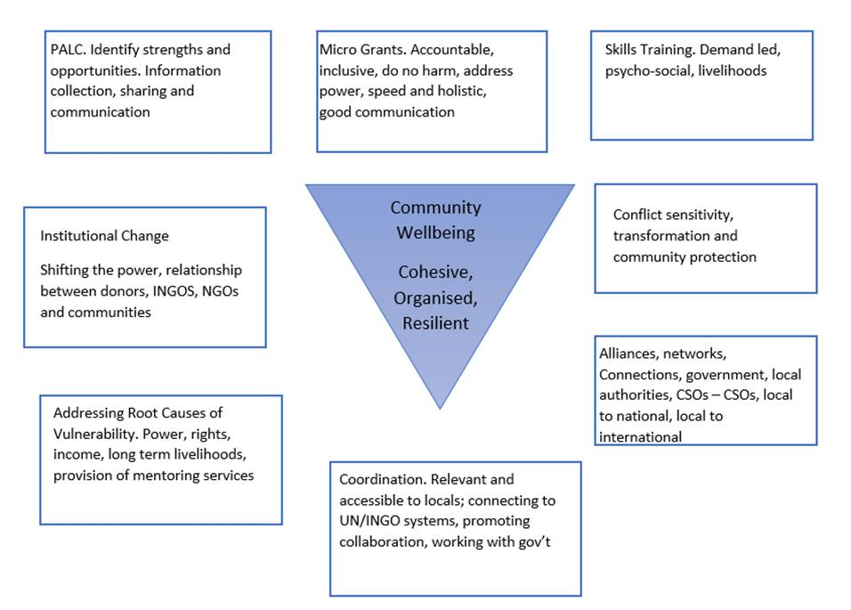
Notes:
From the 3 workshops the local partners, community members and local government ‘translated’ the 6 no regrets into these 8 steps or building blocs.
As you can see there are some steps which are:
Specific ‘humanitarian’ (PALC, micro-grants),
Some which are typically a ‘development’ realm: institutional change, root causes/livelihoods, coordination. Alliances and networks
And from the security sector: CS
But they are all centred around the idea of community wellbeing – and a cohesive, organised and resilient community, with strong social fabric and networks

Slide 15
The LPRR pilots:
Run from September 2017 till end of January 2018
Microgrants: 27 HSGs/CBOs/VDCs reaching 1,820 HHs
Kenya (£30,000x 3 partners – PACIDA, CIFA and MIONET)
Myanmar (£30,000 x 4 partners- KBC, DEAR MM, BBS and MRF)
Type of interventions:
55% livelihood recovery/diversification;
25% access to services (water, education);
15% relief (food and cash)
5% (2) peace building

Slide 16
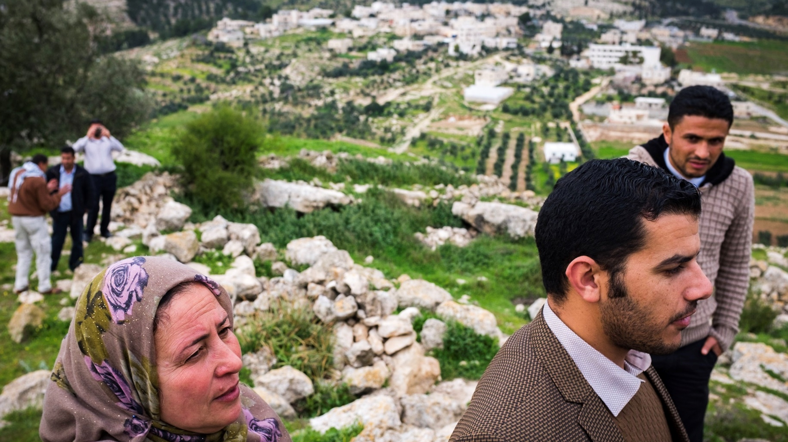
Survivor/community-led response
https://vimeo.com/312168167
Notes:
From that experience and others from Philippines and OPT and Sudan we have put together a short video summarising the approach and the proven benefits (we have evidence)

Slide 17
For more information: https://www.local2global.info/
Contacts:
Nils Carstensen nic@dca.dk;
Henrik Fröjmark henrik.frojmark@svenskakyrkan.se ;
Simone Di Vicenz SDiVicenz@christian-aid.org
Notes:
LGP:
working group of several international humanitarian NGOs (Christian Aid, Action Aid, DKH, Oxfam, DCA, Church of Sweden, Trocaire, CAFOD, War Child), CaLP and ACT Alliance
a network of 18 NNGOs from Philippines, Myanmar, OPT, Sudan, Kenya, Somalia become part of Local to Global community of practice focusing on advocacy, sharing learning and improve practice

