Slide 1
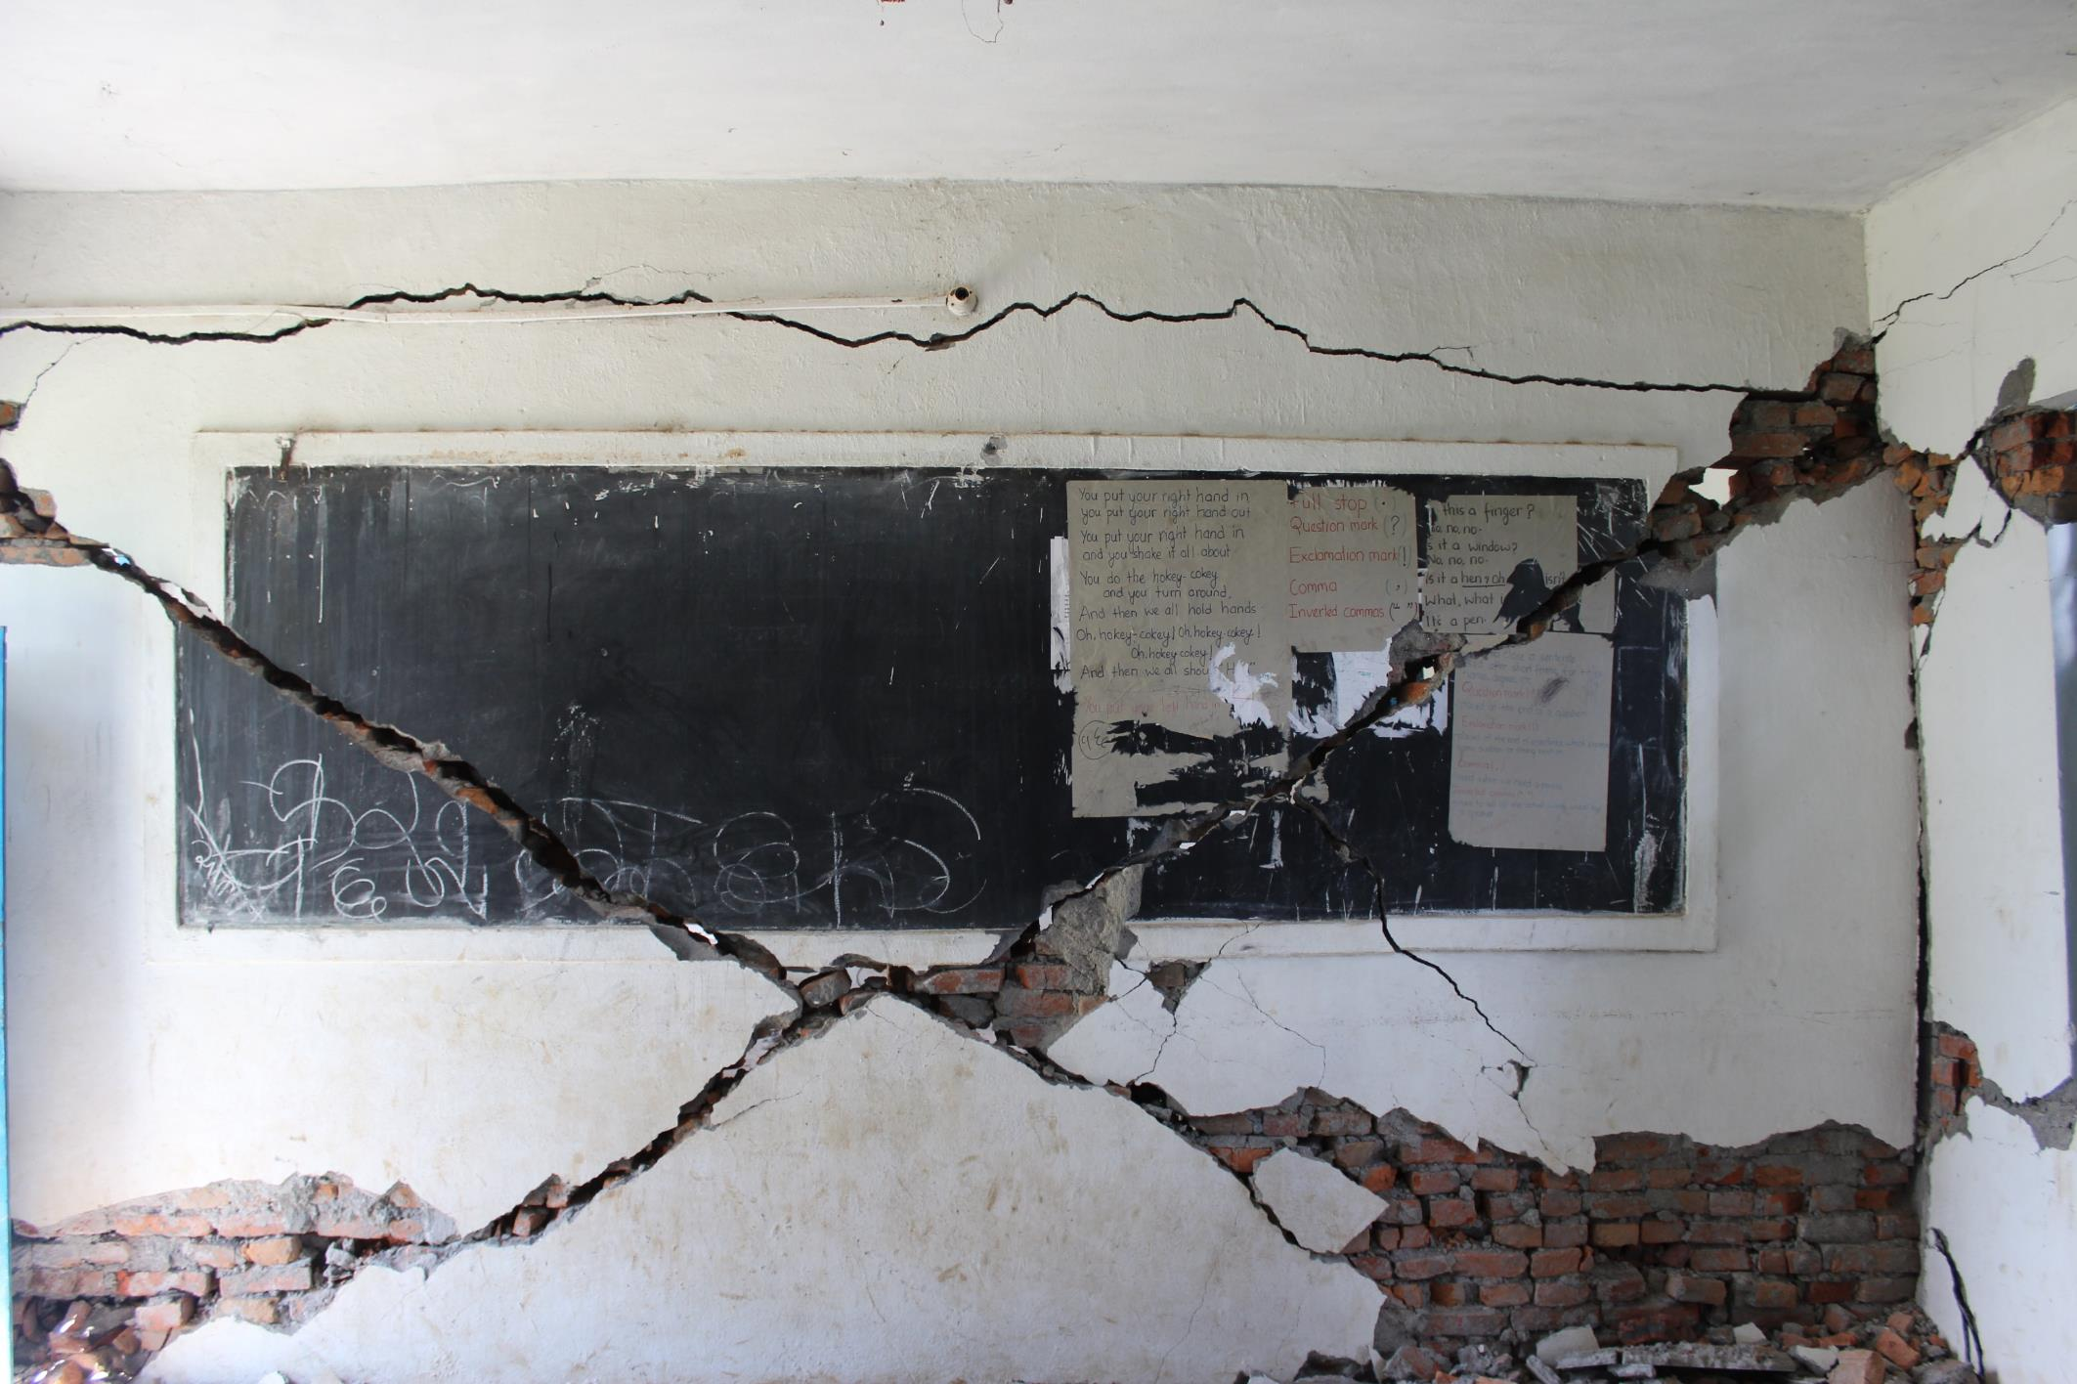

Post-Disaster Assessment of Community-Based Safer School Construction Projects in Nepal
Dr. Rebekah Paci-Green, Dr. Bishnu Pandey, and Rob Freidman

Slide 2

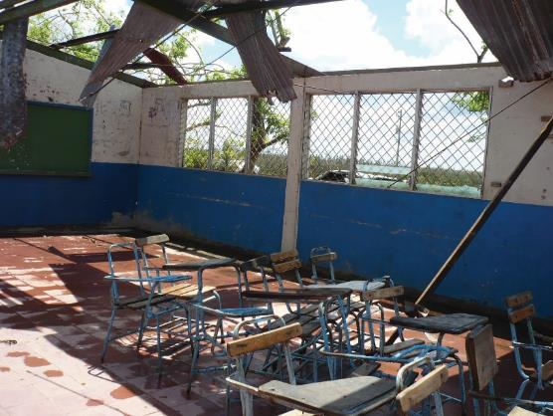

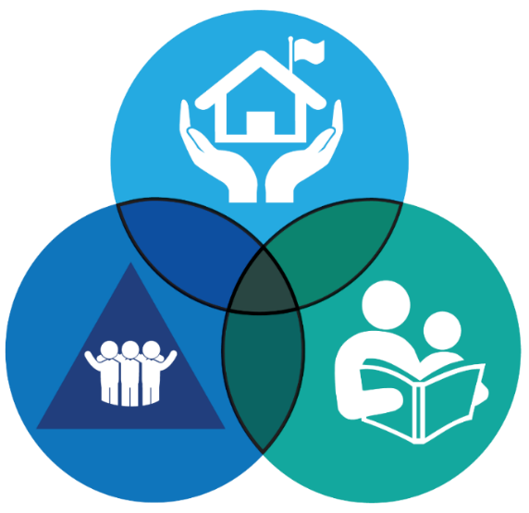
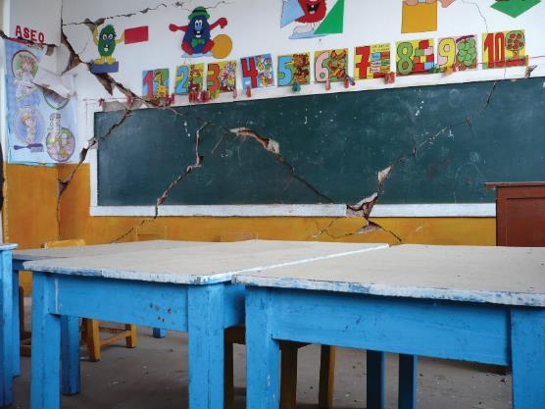

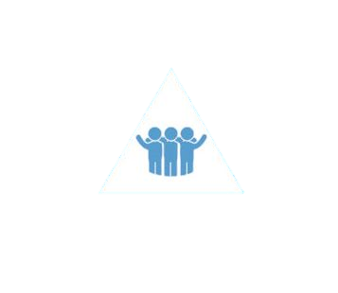


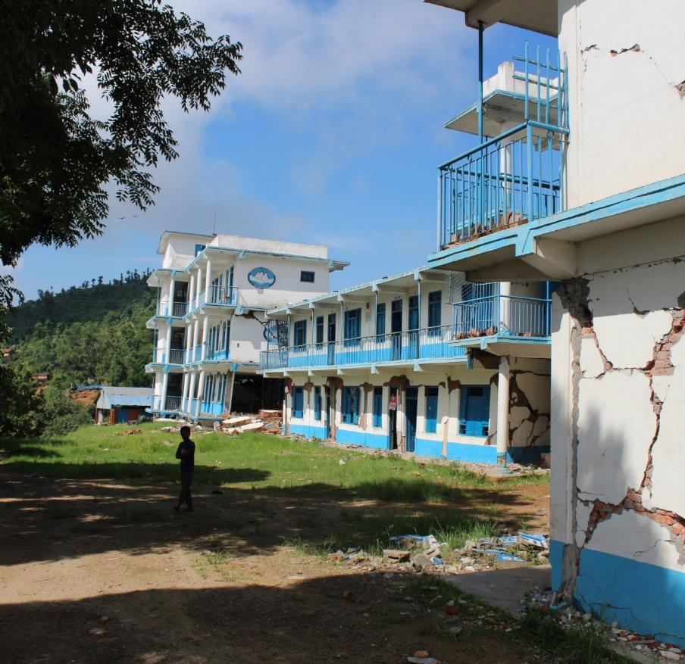
Do community-based safer school construction projects result in . . . .
Comprehensive School Safety Framework
Pillar 1. Safe Learning Facilities
. . . safer facilities?
Photographer: Claudio Osorio, INEE
Pillar 2. School Disaster Management
. . . better disaster management?
Pillar 3. Risk Reduction and Resilience Education
Photographer: Claudio Osorio, INEE
Photographer: Claudio Osorio, INEE
. . . learning beyond the school site?
Purpose of the Guide
Notes:
Until the 1980s, school construction in most developing countries was centralized at the level of the ministry of education or the ministry of public works.
Over time, however, it became apparent that the centralized approach often resulted in inadequate classroom allocation, weak monitoring capacity, and low quality of construction. In order to address the central government’s lack of capacity and to empower local communities, education ministries in the 1990s started to delegate the management and execution of school construction to contract management agencies (CMAs), social funds (SFs), or NGOs. Finally, a third approach emerged: decentralizing school construction to local governments and communities to bring the decision making process closer to the beneficiaries.
Very little sector guidance for small scale community-based school building projects with a specific focus on disaster resilience and safety (with the notable exception of the growing body of work on post-disaster reconstruction).

Slide 3
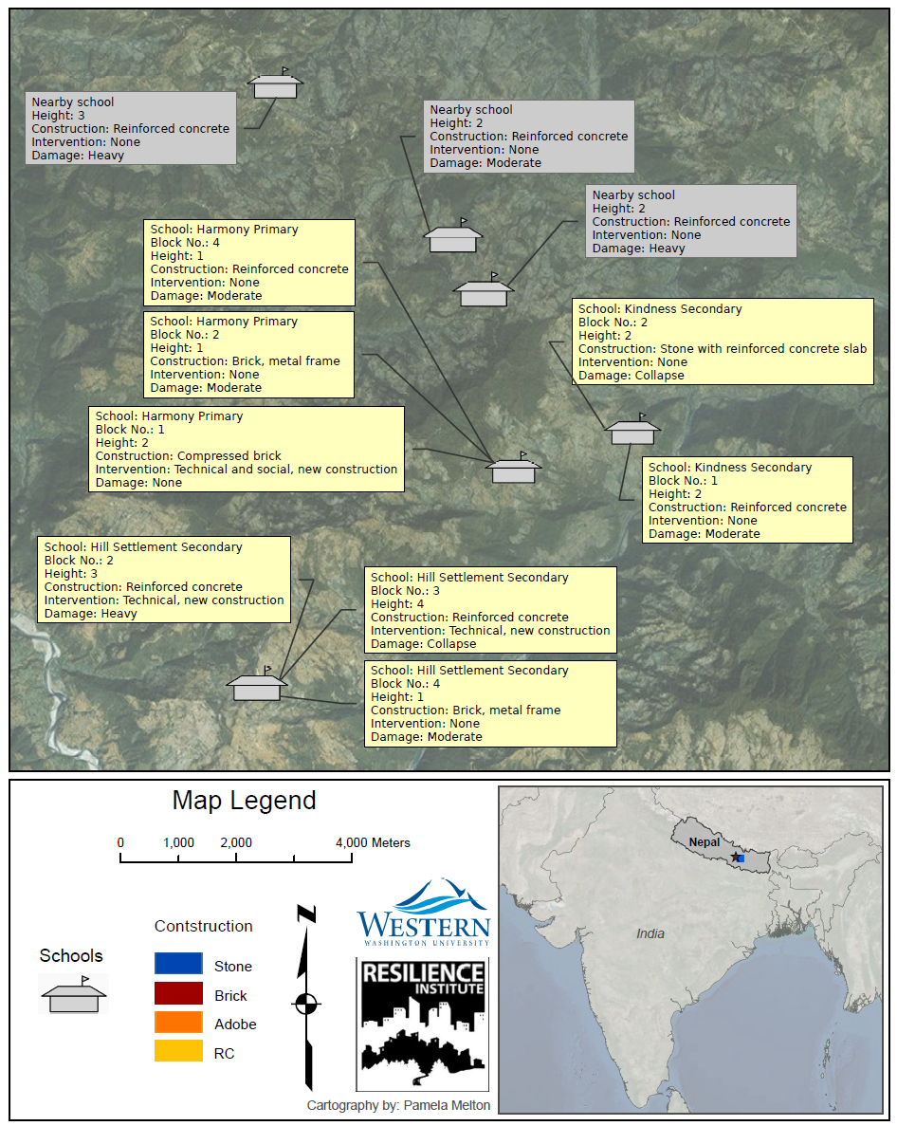
Methodology
  Four Districts
  Three schools near each other, selected without knowledge of disaster impacts
    Standard MoE construction
    Safer school construction without community engagement
    Safer school construction with community engagement

Slide 4
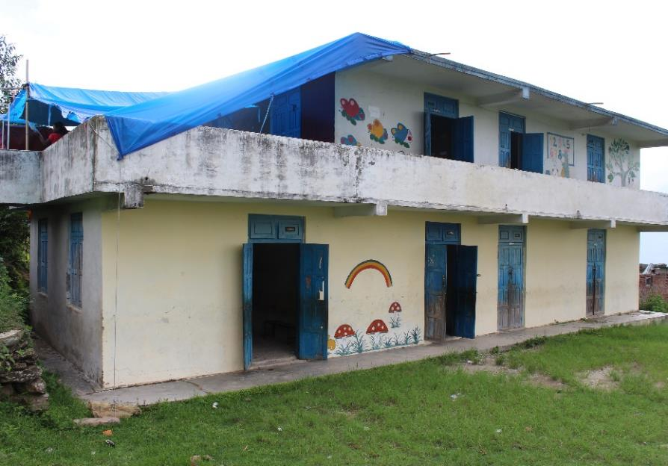
Pillar 1. Safe Learning Facilities
Do community-based safer school construction projects result in safer school facilities?
Paci-Green, 2016, Nepal school retrofit assessment

Slide 5
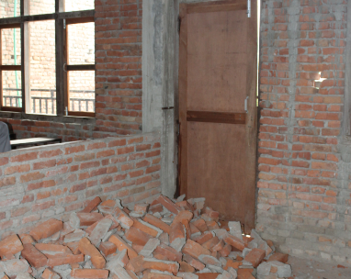
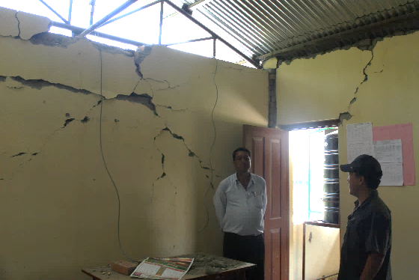
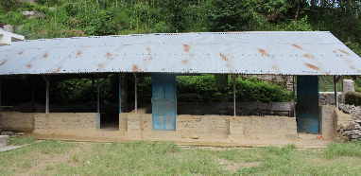
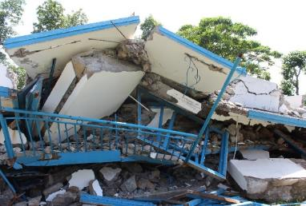
Pillar 1. Safe Learning Facilities
Dist. | Construction Process | Building damage
Bhaktapur | Standard | Moderate
 | Project without community engagement | None
 | Community-based project | None
Kathmandu | Standard | Moderate
 | Project without community engagement | None
 | Community-based project | None
Rasuwa | Standard | Moderate
 | Project without community engagement | Collapse
 | Community-based project | None
Sind’chowk | Standard | Collapse
 | Project without community engagement | Collapse
 | Community-based project | None
Paci-Green, 2016, Nepal school retrofit assessment

Slide 6
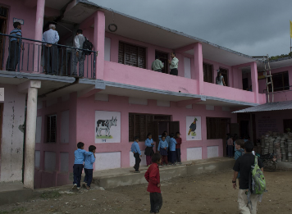
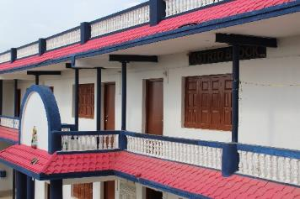
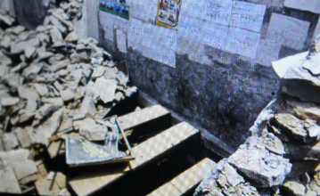
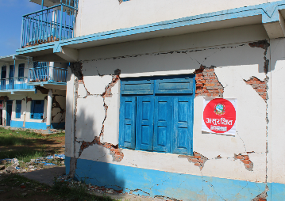
Pillar 1. Safe Learning Facilities
Dist. | Construction Process | Building damage
Bhaktapur | Standard | Moderate
 | Project without community engagement | None
 | Community-based project | None
Kathmandu | Standard | Moderate
 | Project without community engagement | None
 | Community-based project | None
Rasuwa | Standard | Moderate
 | Project without community engagement | Collapse
 | Community-based project | None
Sind’chowk | Standard | Collapse
 | Project without community engagement | Collapse
 | Community-based project | None
Paci-Green, 2016, Nepal school retrofit assessment

Slide 7
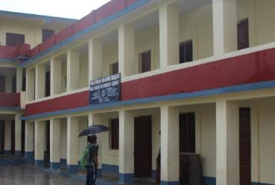
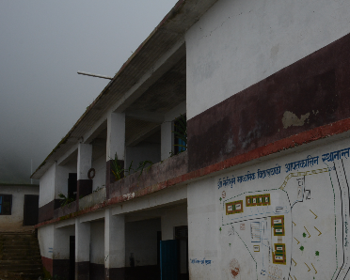
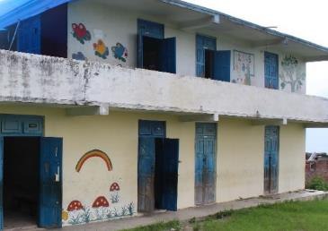
Pillar 1. Safe Learning Facilities
Dist. | Construction Process | Building damage
Bhaktapur | Standard | Moderate
 | Project without community engagement | None
 | Community-based project | None
Kathmandu | Standard | Moderate
 | Project without community engagement | None
 | Community-based project | None
Rasuwa | Standard | Moderate
 | Project without community engagement | Collapse
 | Community-based project | None
Sind’chowk | Standard | Collapse
 | Project without community engagement | Collapse
 | Community-based project | None

Slide 8
Pillar 2. School Disaster Management
Do community-based safer school construction projects result in better school disaster management?

Slide 9
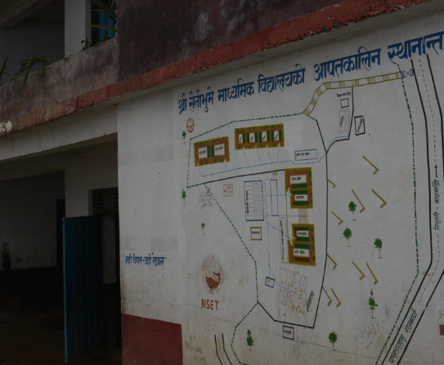
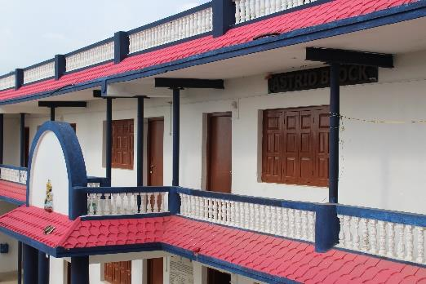
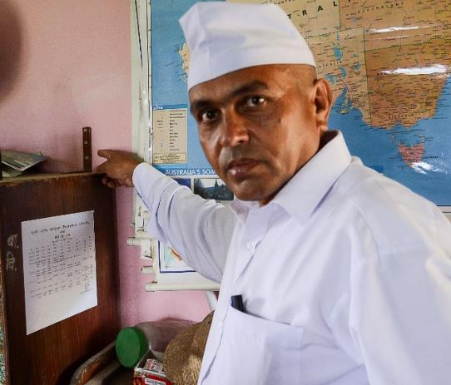
. . . and with community engagement
Pillar 2. School Disaster Management
Safer school construction without community engagement . . .
Jump?!

Slide 10
Pillar 3. Risk Reduction and Resilience Education
Do community-based safer school construction projects result in learning beyond the school site?

Slide 11
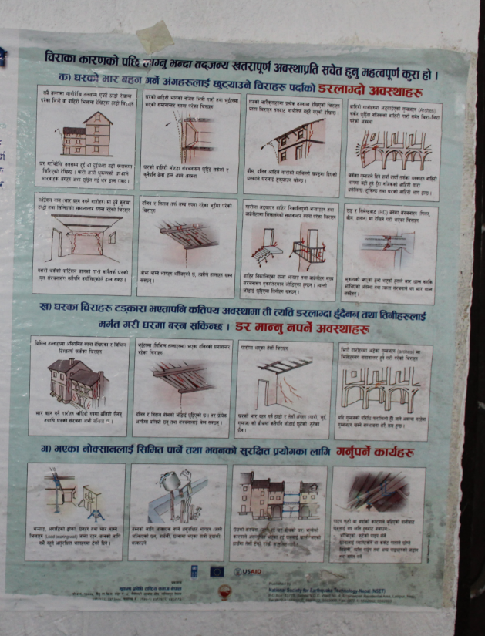
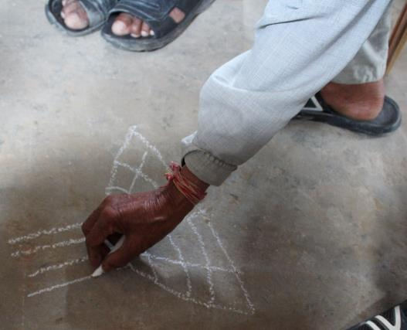
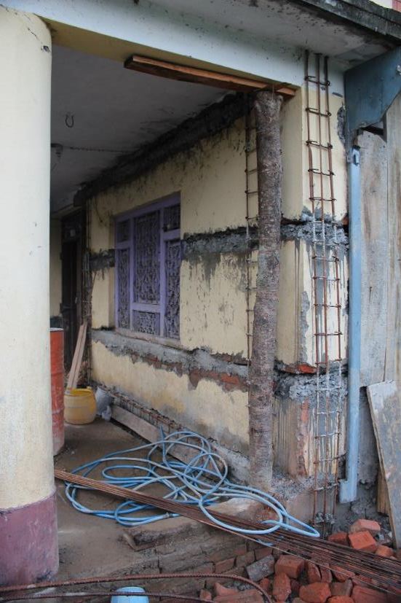
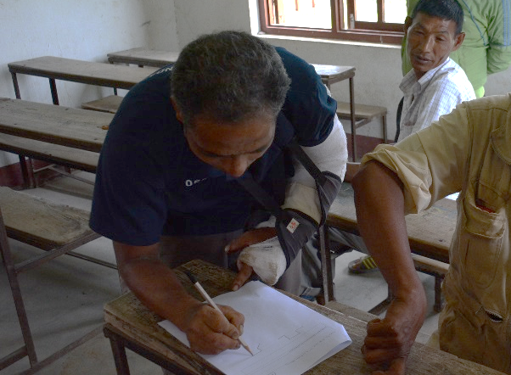
Pillar 3. Risk Reduction and Resilience Education

Slide 12

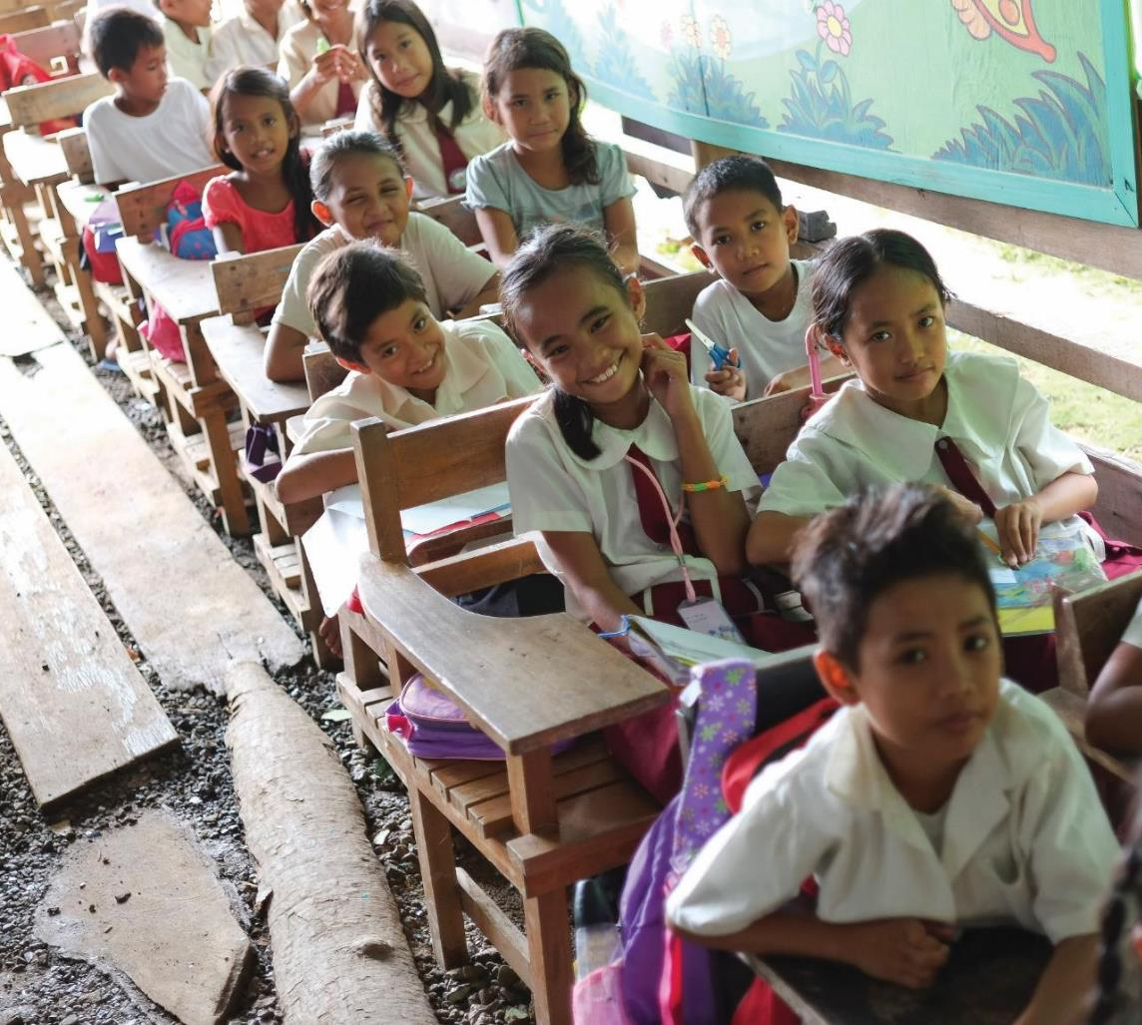








Manual , videos, case studies, pledge: saferschoolconstruction.com
Resources at: saferschoolconstruction.com
Towards Safer School Construction
A community-based approach
Additional Partners in creating Towards Safer School Construction films:
Notes:
School construction needs to be about building safer schools, but I think this research shows it can be so much more than that. When combined with community outreach, mason training, and education about hazards and disaster risk reduction, these projects can also:
Raise awareness about hazards within communities
Build local capacity for safe construction practices
Strengthen a culture of safety within and around the school
Increase a sense of community ownership of the school
Ensure community values are incorporated into school designs
If you would like to learn more about strategies used in Nepal, and many other places, where a community-based approach is being taken, please go to saferschoolsconstruction.com. You’ll find six videos that explore the principles behind the good practices in the field. There’s also case studies, guidance on implementation and a manual for carrying out safer school construction with communities.

