Slide 1
Development of Jordan International USAR Team
The First Arab Conference on Disaster Risk Reduction
Aqaba, Jordan - 19-21 March 2013
Col. Marwan Bader
Director of Planning – Jordan Civil Defence

Slide 2
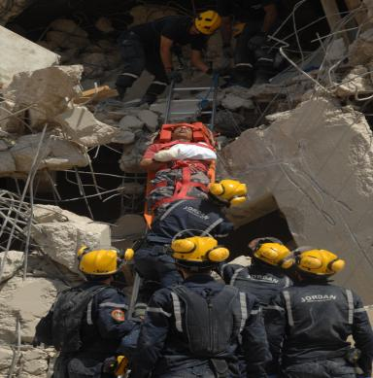
Development of Jordan International USAR Team
Introduction:
Role of JCD in Protecting Lives and Properties.
Role of JCD at all Levels of Jordanian Crisis Management System.
The Bomb Attacks 2005 & Hyogo Framework Impacts on JCD Capacity Building. 1.DAT

Slide 3
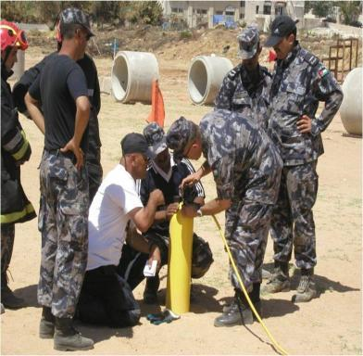
Development of Jordan International USAR Team
JCD experience in capacity Building:
Preparing for the UN INSARAG external certification (IEC).
Sharing experiences in:
Lunching National Comprehensive Plan & a national strategy.
Training facilities and Training methodology.
Command , control & Communication.
Haz-Mat & medical
Logistics & INSARAG methodology

Slide 4
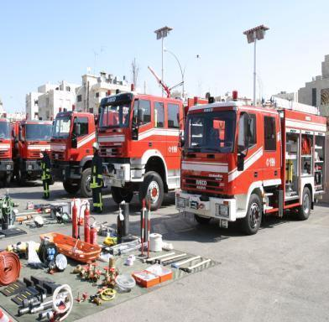
Development of Jordan International USAR Team
JCD experience in capacity Building:
Development at the Operating level:
Training of the JCD units.
(163 centers/stations) was launched.
Purchasing of material.
Building an emergency warehouses, shelters.
Preparing civil defense volunteers instructions.

Slide 5
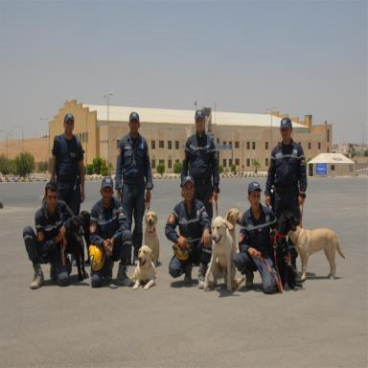
Development of Jordan International USAR Team
JCD capacity Building results
Jordan has an international USAR team which prepares for the INSARAG external classification this year.
USAR team can form a focal point to transfer knowledge to other regional teams that seek to develop it-self.

Slide 6
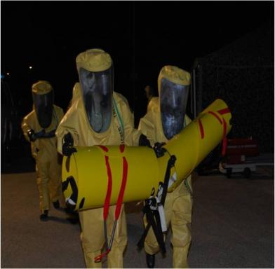
Development of Jordan International USAR Team
Motivations & Challenges:
Challenges :
Project management:
Capacity building for project management skills.
Result - Based approach.
Local disasters management process.

Slide 7
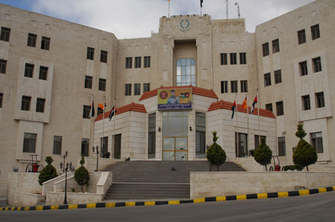
Development of Jordan International USAR Team
Motivations & Challenges:
Challenges :
Measures within own organization (JCD):
Improving the ability of local staff to effectively use skills to do tasks.
Providing needed Monitoring and coaching and supporting (EXCON) unit.
Solving Inadequate training facilities, essential technical tools and limited capacity obstacles .
Providing Training methodology and training modules.

Slide 8
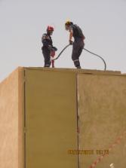
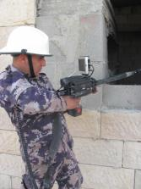
Development of Jordan International USAR Team
Motivations & Challenges:
Challenges :
Cultural Differences:
National accepted culture.
Language.
Finances:
Define financial policy and procedures.
Make provision for on-going funding.
Lack of finance resources for capacity building.
Providing and financing the needed training to qualify concerned teams.

Slide 9
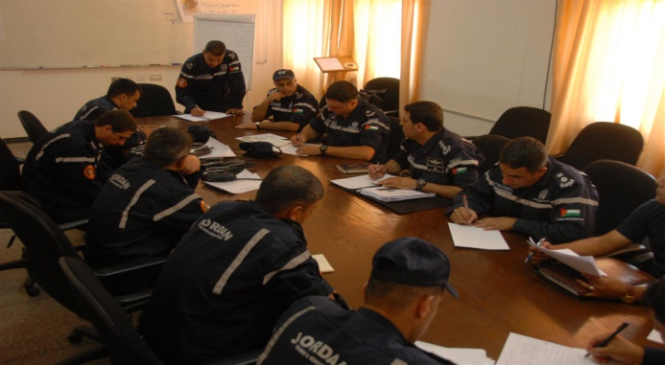
Development of Jordan International USAR Team
Motivations & Challenges:
Challenges:
Best practices in knowledge transfer
Translating INSARAG guide line to Arabic.
Mutual relation with other teams.
Provide assistance for USAR team to form a focal point to transfer knowledge.
Sustainability
Financing sustainability
Financing deployment.
Open INSARAG regional office in Jordan.
Participating of USAR team in all activities.

Slide 10
Development of Jordan International
USAR team
Thank you

